Slide 1
Improving Community Food Systems:
Food Councils in the Charlotte Region

Slide 2
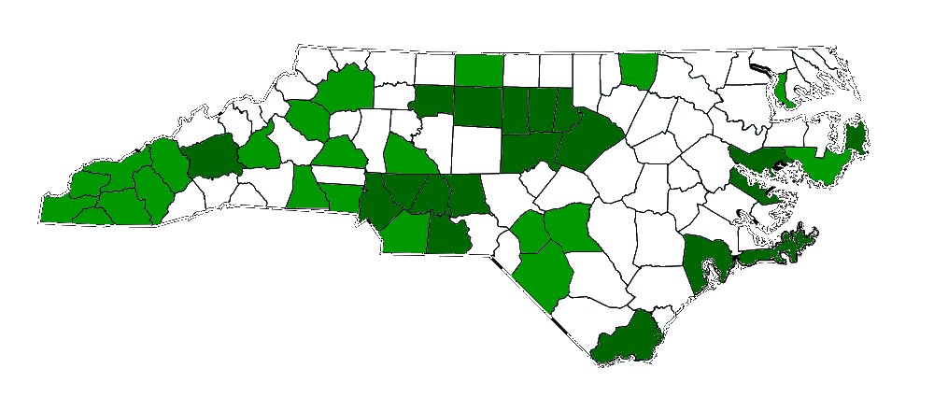
Improving Community Food Systems:
Food Councils in the Charlotte Region
Abbey Piner
Community Food Strategies
apiner@ncsu.edu
Aaron Newton
Cabarrus Farm and Food Council
Erin Brighton
Charlotte-Mecklenberg Food Policy Council
Shawn Hatley
Upper Pee Dee Food Council

Slide 3
Session Take-Aways
Food councils are examples of the importance, opportunity and benefits of cross-sector collaborations.
Best Practices for Food Councils – 5 years in:
  Diversified leadership is essential for a sustainable food council.
  Food council best practices include having at least part time paid coordination.
Intentional networking as successful action: Successful food councils create and enliven a space for collaboration. (And sometimes food councils take action).

Slide 4
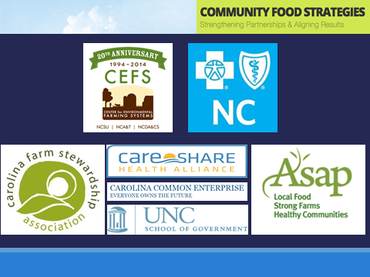


Slide 5
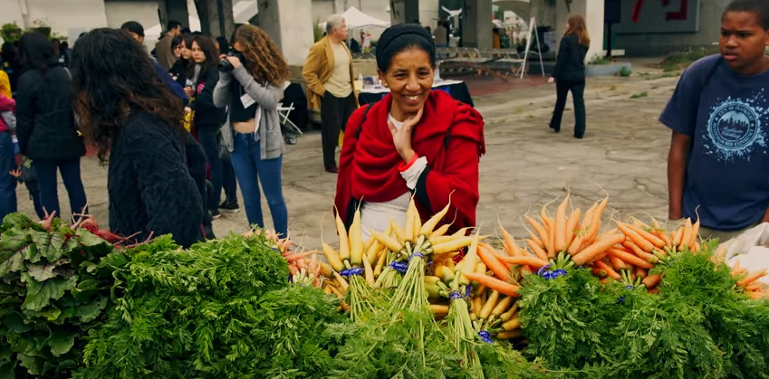
What is a food council?
https://www.youtube.com/watch?v=ooe8dURgHsA
Food councils are community organizations that help promote stronger local food systems. They assess the current food situation, make recommendations on how to improve it and communicate recommendations to policymakers and organizations that can take action.
Notes:
Let’s show the first 1:38 of this LA food council video and have folks write down the ‘key words’ they hear/notice.
Have folks say those words out loud….
That frames the ‘what is a food council’ conversation….

Slide 6


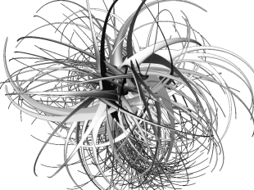
…are food councils needed?
WHY
Collaboration
Shared View
What Works?

Slide 7

Food councils provide a shared way of thinking about the whole community food system.

Slide 8
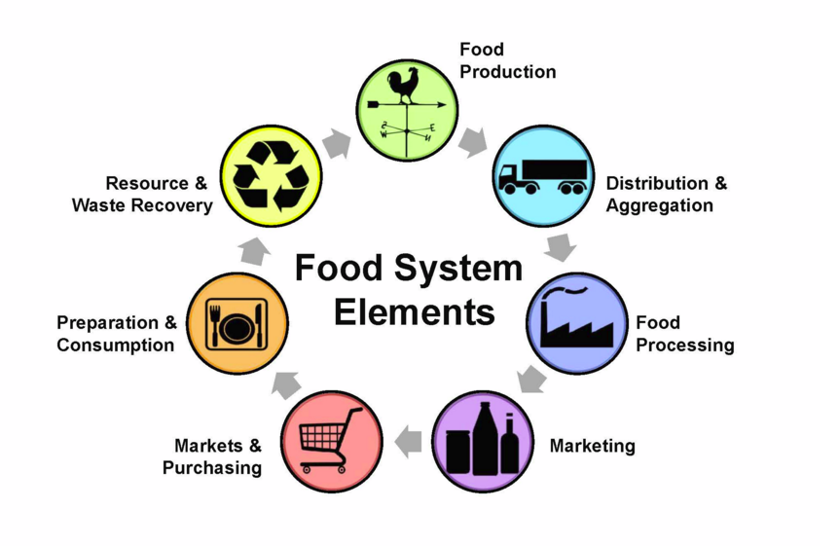

Slide 9
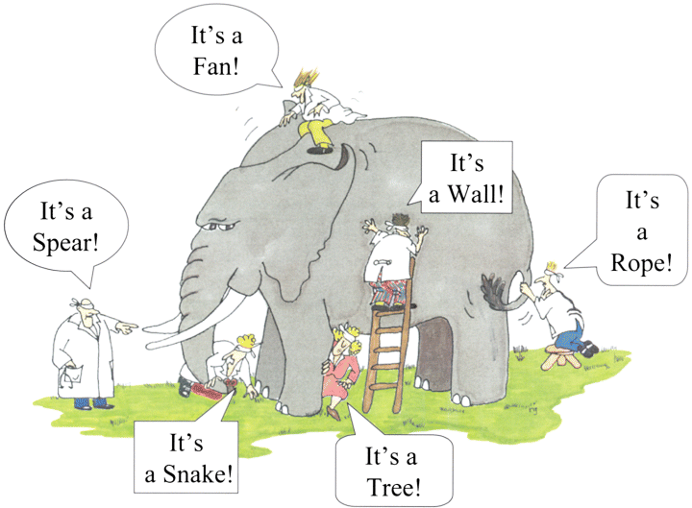
Blind Men and the Elephant By John Godfrey Saxe (1816–1887)
WHY?

Slide 10


Slide 13
…do food councils DO?
WHAT
Facilitate Connections
Provide Focus
Drive Action

Slide 14
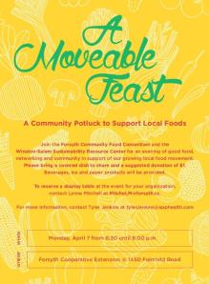
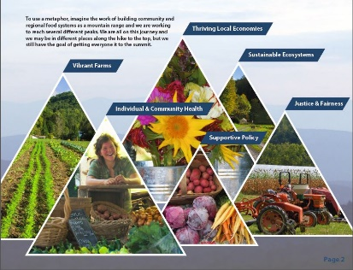


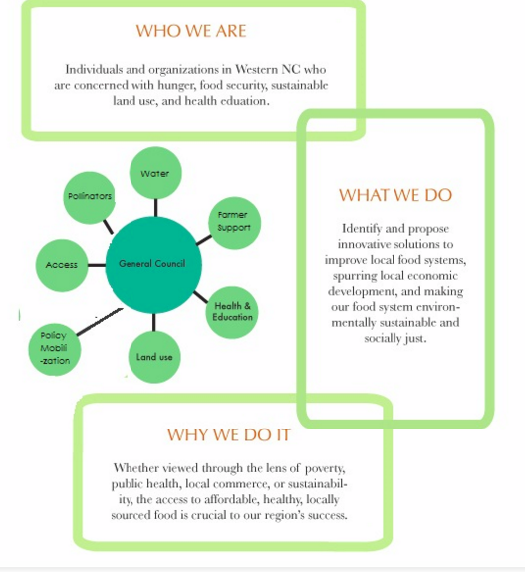
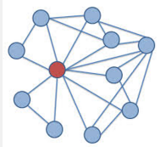
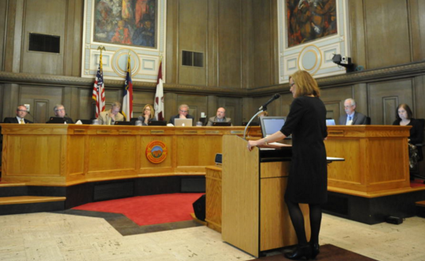
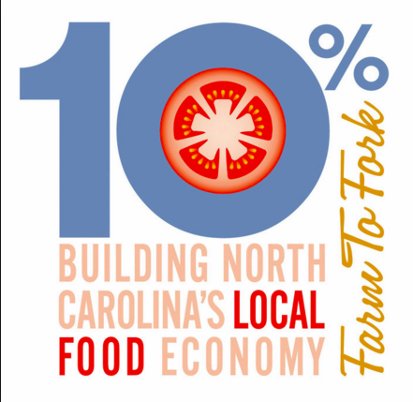

Facilitate Connections
Provide Focus
Drive Action

Slide 15
…do food councils succeed?
HOW
Attend to People
Attend to Purpose
Attend to Process

Slide 16
Food councils hold themselves and the community accountable to the question:
What does a vibrant community-based food system look like for our community?

Slide 17
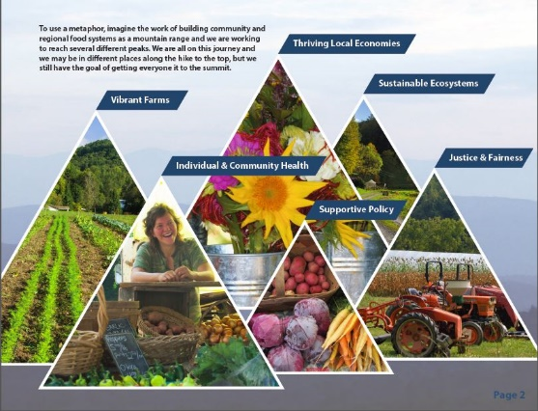
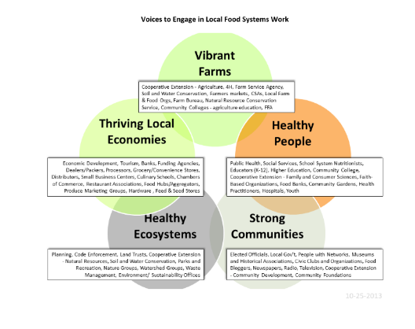
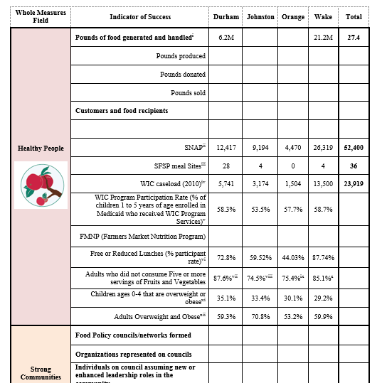
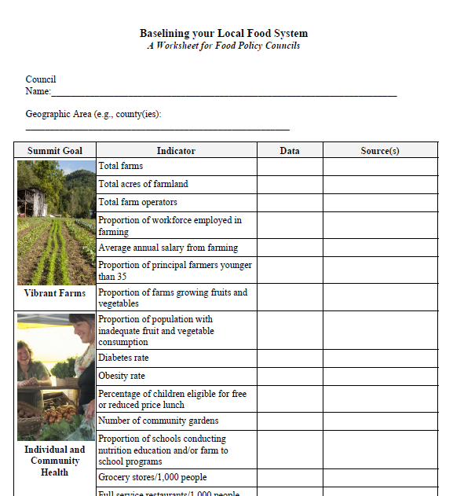
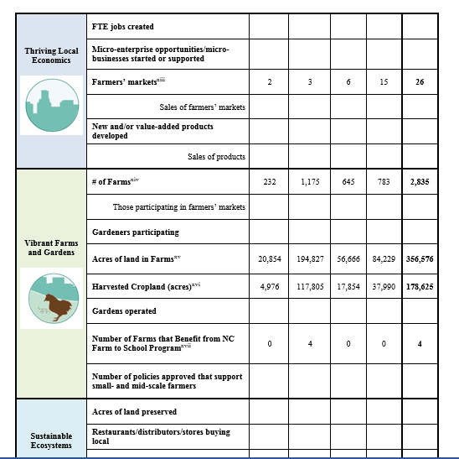
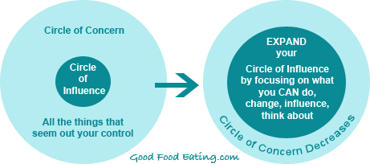
Attend to People
Attend to Purpose
Attend to Process
Notes:
Assessments
Priorities
Mission, Vision, Values

Slide 18
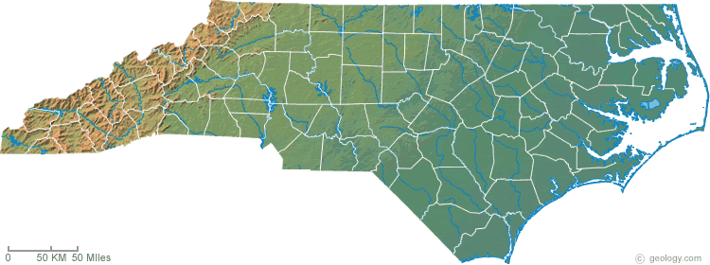

35 Councils representing 43 counties are existing or emerging in NC.
Notes:
The national food policy council trend has continued in North Carolina. Since 2006, 10 new food councils have formed, including:
Feast Down East in Wilmington, New Hanover County
Cabarrus County Farm and Food Council
Charlotte-Mecklenburg Food Policy Council
Durham Farm and Food Network
Western NC Food Policy Council, covering Clay, Cherokee, Graham, Macon, Jackson, Swain, and Haywood
Farm, Food, and Family Council of Robeson County
All-American Homegrown in Fayetteville, Cumberland County
Upper PeeDee Farm and Food Network, covering Anson, Stanly, and Montgomery
In addition to counties at the local and regional level, state food councils have been established:
Local Food Council of North Carolina
Food Youth Initiative & Youth Food Council

Slide 19
Some best practices are emerging:
Strategically cross-sector (whole measures)
Baseline assessments to set priorities and focus
Diversified leadership is essential for a sustainable food council
Champions and relationships in local government and in community groups
Food council best practices include having at least part time paid coordination.

Slide 20
Three Charlotte Region
Food Councils are improving our community food systems:

Slide 21
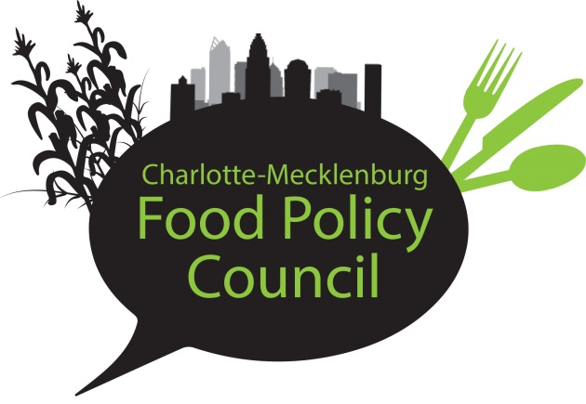
Charlotte-Mecklenburg Food Policy Council
Erin Brighton, MPH, M.Ed., Director

Slide 22
Our Top Food Policy Issues
Charlotte’s Top Food Policy Issues
Food Access & Distribution
Barriers to Local Food Entrepreneurs
Childhood Nutrition
Lack of Current Data: Research/Studies
Farmer Succession Planning

Slide 23
CMFPC Structure
Board of Directors
CMFPC Team
Secretary
Elizabeth DeBragga
(Compass Group)
Treasurer
Marisa Faigen
(Foodbuy)
Board Chair
Young-Sun Roth
(Bank of America)
CMFPC Director
Erin Brighton
FoodCorps Service Members
Katie McCrea
Jacob Huffman
Director
Megan Liddle Gude
(Center City Partners)
Director
Victor Romano
(Johnson C. Smith University)
Director
Katherine Metzo
(Winthrop University)
Intern(s)
Development
Research
Research & Experts Panel
Director
Nadine Ford
(Mecklenburg County Solid Waste)
Director
Kate Uslan
(Alliance for a Healthier Generation)
Director
Karina Gonzalez
(Mecklenburg County Health Dept)
Volunteers
Experts Panel
Marketing & Communications
Marketing & Communications
Director
Reggie Singleton
(Mecklenburg County Health Dept)
Director
Erin Coomer
(Novant Health)
Experts Panel Members

Slide 24
CMFPC Vision, Mission, Focus & Goals
Vision
Good, affordable, healthy food for all
Mission
Advocate for policies that build a sustainable, equitable, & healthy local food system
Focus Areas
Healthy Food Access Policy
Advocate for policies to increase access to healthy foods for all Charlotte residents, focusing on low-income citizens
Local Food Policy
Advocate for policies to strengthen our local economy & environment by supporting our local farmers, food producers & entrepreneurs
Goals
    Enhance health of Charlotte-Mecklenburg residents
    Strengthen local economy & market opportunities
    Reduce hunger & food insecurity
    Strengthen connections & networks between people and groups

Slide 25
CMFPC’s Role in the Community
Examples of our Work
Advocate
Identify food-related policy issues;
work with policy makers throughout the community to amend and alleviate.
2010 Food Assessment identified areas of need
2013 discussion with
City Council Economic Development Committee
2015 new zoning ordinance allowing Mobile Farmers Markets access to under-served neighborhoods
Educate
Engage and empower through
communities with information about
nutrition, cooking and local agriculture. Key groups include:
West Blvd Neighborhood Association
Stratford-Richardson YMCA
Barringer Academic Center
Reid Park
Convene
Bring together
the right people
at the right time to recognize and address the need.
2013: Health Department nutrition educators, teachers and gardeners came together from Friendship Gardens to launch the School Garden Network
CMFPC Experts’ Panel
Notes:
Advocates
We influence food policy changes with key city, county, state and community decision makers.
Step 1: Identify health disparities & food deserts (2010 assessment)
Step 2: Share findings (presentation to City Council Economic Development Committee, lead discussion on how to solve it.)
Step 3: Work with city officials to identify and act on solutions (Two years of work with city officials to design and pass a text amendment to the zoning ordinance so that mobile farmers markets are permitted to serve neighborhoods without grocery stores. The final text amendment was passed in May 2015.)
Educators
We engage, educate, and empower the community on the importance of healthy food and food system barriers.
Built relationships with the West Blvd Neighborhood Association, Stratford-Richardson YMCA, Barringer Academic Center and Reid Park to educate students, teachers, and parents about nutrition, gardening, and cooking. Helped establish goals to increase healthy food access, parent involvement and sustainable gardens. Broadening reach to over 200 kids/mo. as we secured Charlotte’s first FoodCorps member.
Conveners
We recognize the needs in the community and bring people and organizations together to address them.
With a grant from Burt’s Bees, we launched the Charlotte School Garden Network and hosted garden tastings at elementary schools in low-income areas. With the Health Dept and Friendship Gardens, we coordinated school garden workshops with teachers and parents across CMS. This initial legwork resulted in the creation of the Green Teacher Network, a flourishing organization.
Experts Panel…

Slide 26
CMFPC Audiences
Who We Influence
Who We Serve
Health Dept
City, County, & State Government Representatives - County Commission Health Committee, City Manager, County Manager, City Council, City Cabinet
Farmers
Public Health Practitioners
Charlotte-Meck Residents
Chefs & Restaurateurs
Food Retailers – grocery stores, restaurants, markets
Gardeners
CMS Schools –
focus on low-income
Local Food Entrepreneurs
Local Food Producers
Business Advocacy Groups – Chamber of Commerce
Local Independent Schools
Institutional Food Buyers – hospitals, colleges, hotels, retirement communities
Corporate Leaders

Slide 27
CMFPC Roadmap Summary
In Progress
Where We Are Going
2014
Strengthen our Foundation,
Refine Focus Areas
2015
Strengthen Advocacy,
Build Momentum
2016
Go-To Food Policy Influencer
Key Activity Categories
Small Food Businesses/
Start-Ups
Hosted Local Food Entrepreneurs Panel (May 2014)
Design & conduct survey/interviews to explore barriers for small food businesses & outline 2015 scope of work based on findings
Farm-to-School
GAP certification for small, local farmers
Advocacy
Lead annual Charlotte-Meck State of the Plate – food assessment
Partner with Queen City Forward on Innovation Challenge FOOD
Partner with CMS to apply for a feasibility grant to purchase local foods for cafeterias
Design system for leveraging Experts Panel & members in advocacy
Leverage FoodCorps Service Member for research & planning
Create “knowledge hub” – digital research archive on the local food system

Slide 28
CMFPC History & Accomplishments
Year | Notable Achievement
2010 | Volunteer group began formal operations Meck County Community Food Assessment Phase 1 Saved Barbee Farm
2011 | Charlotte-Mecklenburg Food Policy, Inc formed as 501(c)(3) 1st Mobile Produce Stand with Friendship Gardens Meck County Community Food Assessment Phase 2 Mobile Farmers’ Markets’ Advocacy West End Food Assessment
2012 | Formed Experts’ Panel CATS Transit Center Fruit Stand with Friendship Gardens CONNECT Our Future Regional Plan Public roundtable “Local Foods as a Business Development Tool” Webinar “Local Food & Food Policy in Meck: Primer for Parents” Co-hosted NC Sustainable Local Food Advisory Council Published Mecklenburg Urban Agriculture Guide
2013 | Burt’s Bees Grant to form the Charlotte School Garden Coalition Participated in Funds to Farms Charlotte City Council Economic Development On Community Leadership Council of Toxic-Free NC Bank of America Environmental Group Self Help Credit Union Open Meeting: Healthy Food Financing

Slide 29
CMFPC History & Accomplishments (cont)
Year | Notable Achievement
2014 | Advised on City Mobile Markets Policy Presentations to Health Dept, City Staff Helped shape state-wide FPC network Launched CMFPC Membership Program White Paper: Food Insecurity Outreach & Community Building Healthy Kids, Healthy Families program in 5 CMS schools Secured first FoodCorps Service Member in region Local Food Entrepreneurs Forum Partnered with Queen City Forward on Innovation Challenge FOOD Partnered with AARP on Hunger Forum 2014 Food Day event
2015 | 2015 Food Day event Connected CMC Northeast to help establish an onsite Farmer’s Market Second FoodCorps Service member began service year GAP certification of the Garinger High School Urban Farm begins Teacher workshops on cooking with students Presentations to community groups Queen City Forward THINKPLENTY State of the Plate food assessment & Action Council

Slide 30
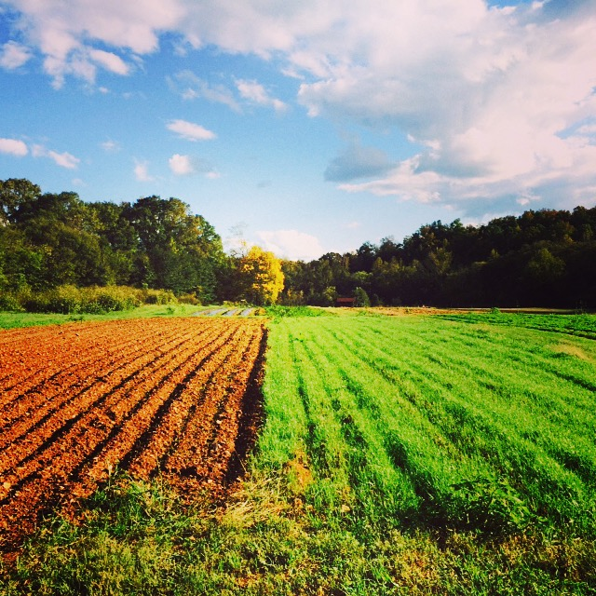
Thursday December 3rd, 2015
Centralina Council of Governments
Cabarrus County Farm & Food Council
Aaron Newton
Carolina Farm Stewardship Association
aaron@carolinafarmstewards.org

Slide 31
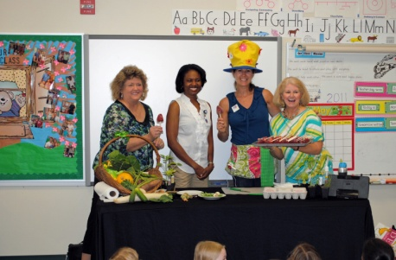
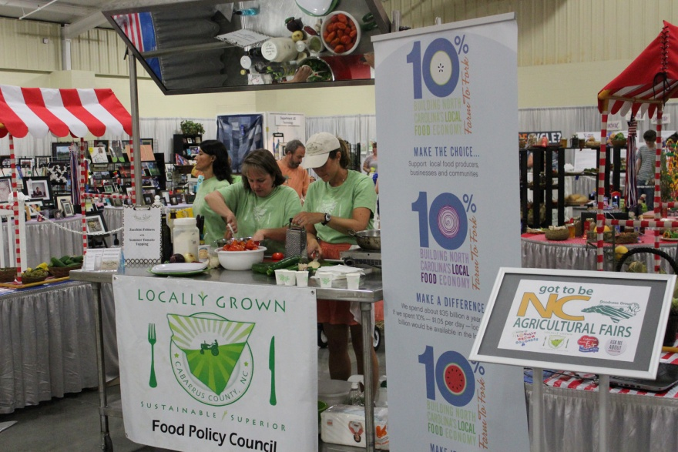
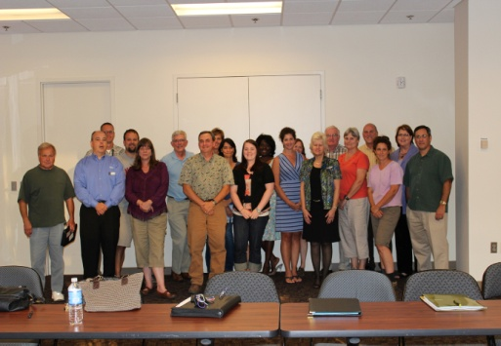

Cabarrus County Farm & Food Council
The group charged with continuous improvement of local food economy revitalization
21 Members holding 3 years terms
Diverse group of stakeholders
Notes:
The group charged with continuous improvement that facilitates the rebuilding of the local food economy through a diverse approach addressing all the components of a healthy food system.
Bottom up grassroots and the top down leadership meeting in the middle equals critical mass
Access (for everyone, distribution, $)
Healthy
Local

Slide 32
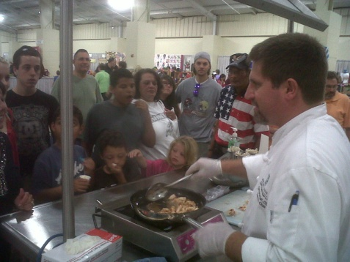
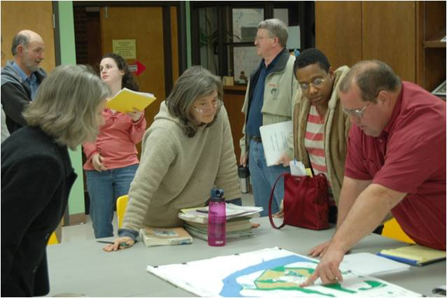
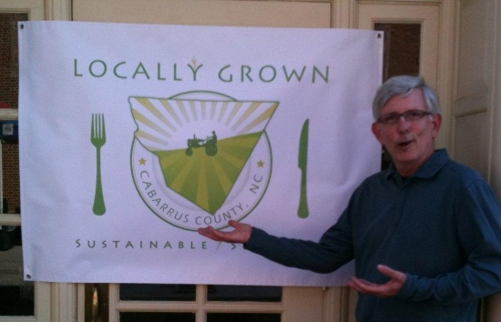
Cabarrus County Farm & Food Council
Open meetings every 2nd Thursday
County assistance includes meeting space and other support

Slide 33

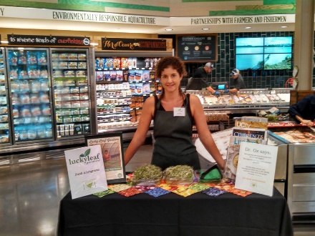
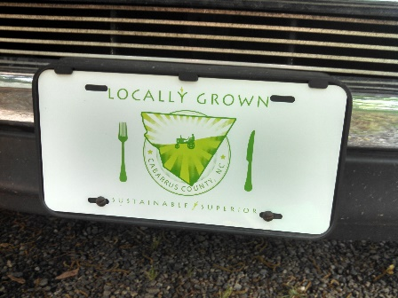
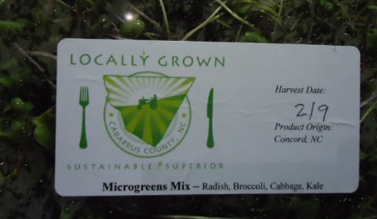
Locally Grown Campaign
CCFFC early achievement
Open for use by local food business
Banner for the cause
Notes:
A licensing agreement allows local food businesses to use the logo to represent their products. Provides brand identity. Serves a network.

Slide 34
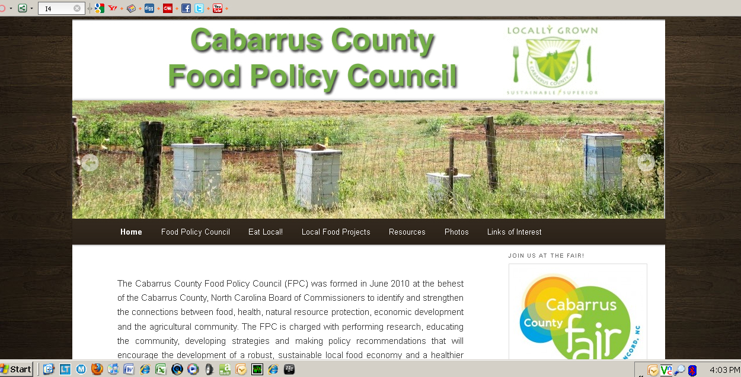
Cabarrus County-focused
Local Food Website & Facebook
CCFFC early achievement
Features information regarding multiple components of the food system
http://www.cabarrusfpc.org/

Slide 35


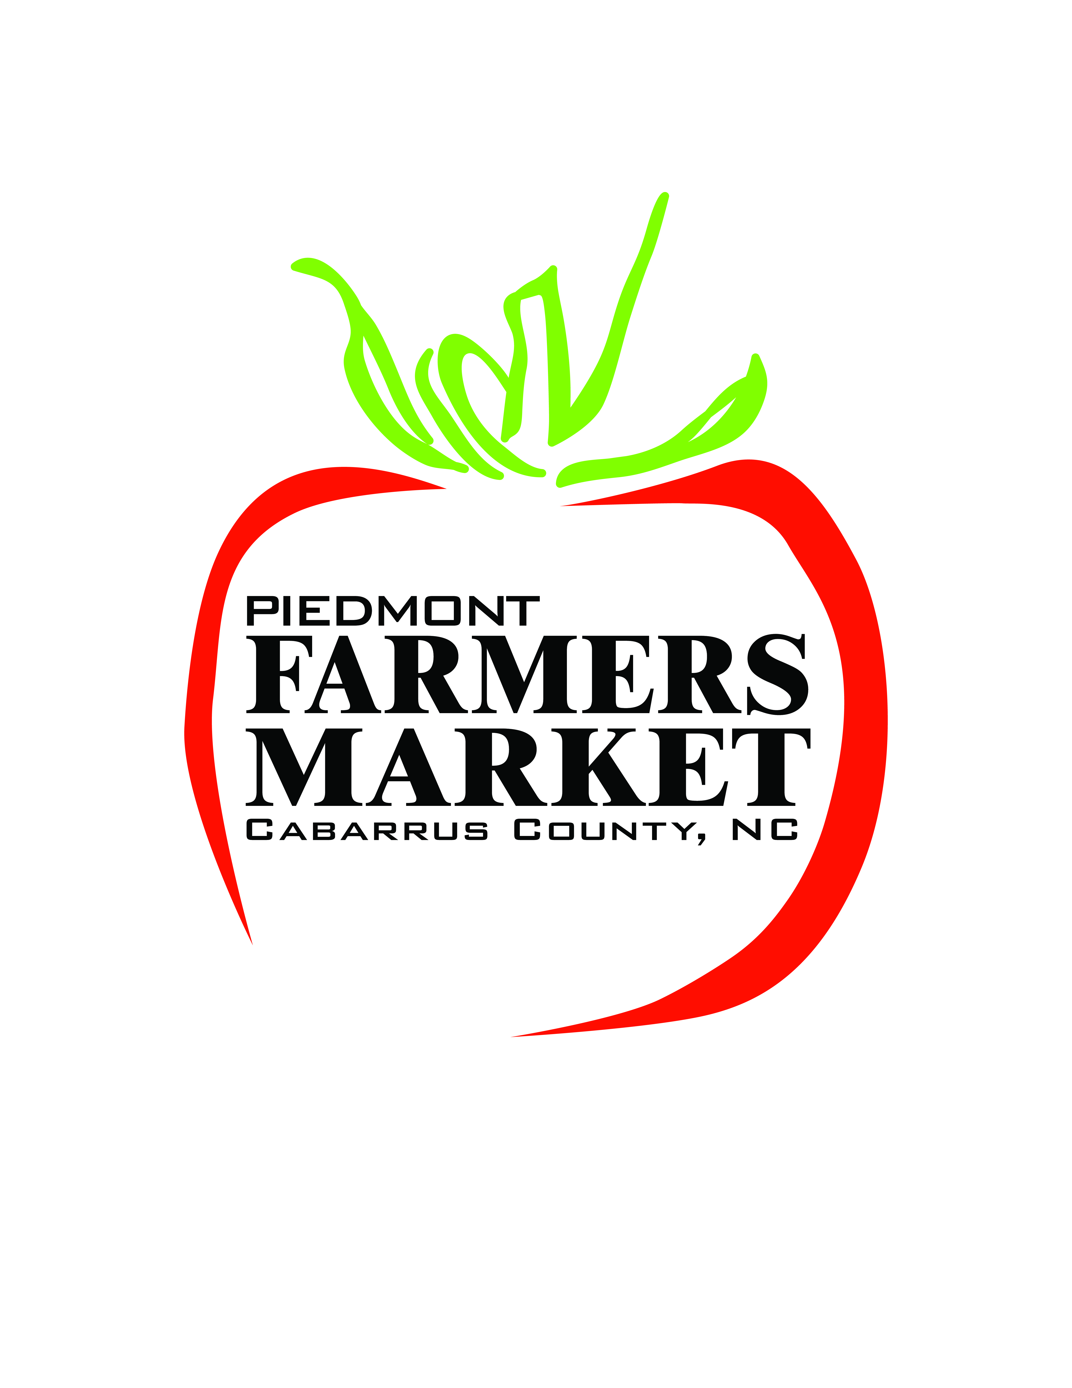


Collaborative Effort!
+
=
Success
+
Notes:
The FPC is organizing all these groups to host a Harvest Gala farmers market annual fundraising event. Ticketed evening event with food and music. Proceeds go to help fund market activates.

Slide 36
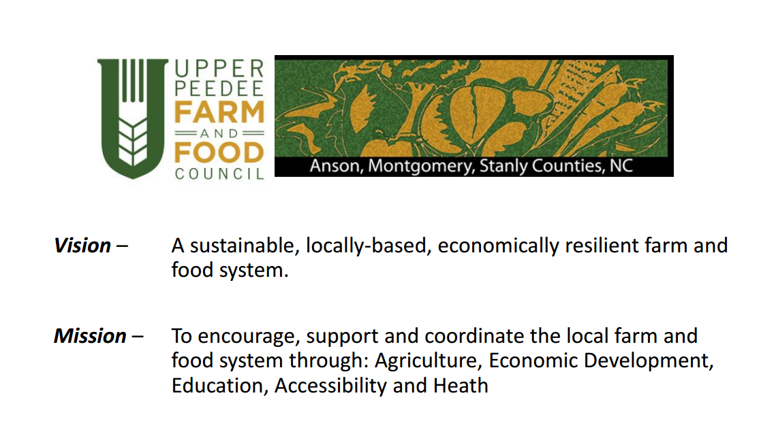

Slide 37
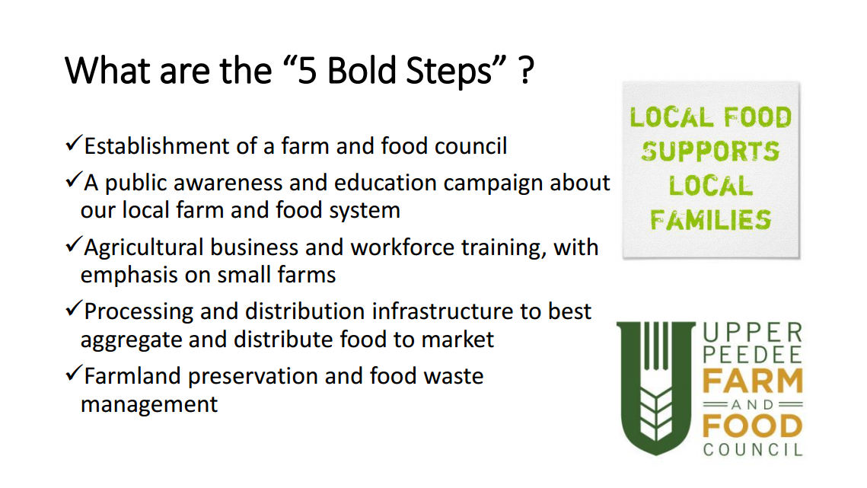

Slide 38
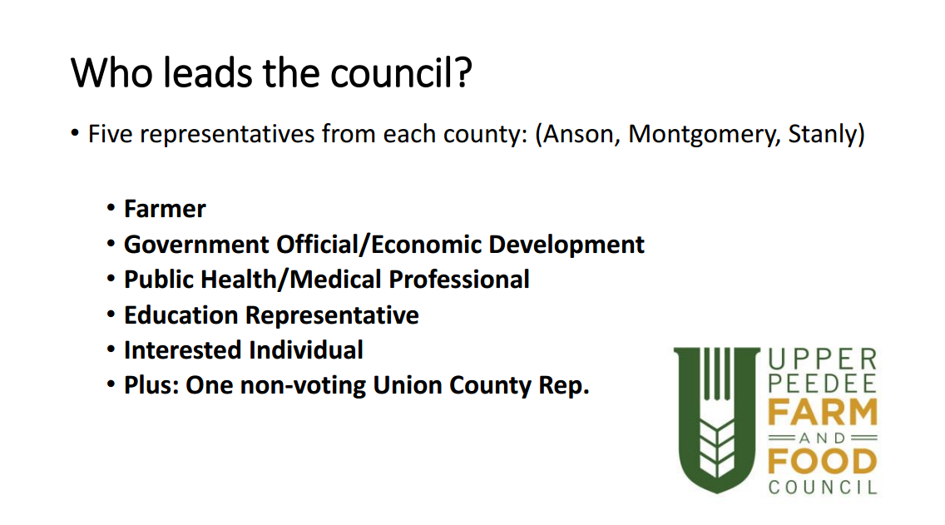

Slide 39
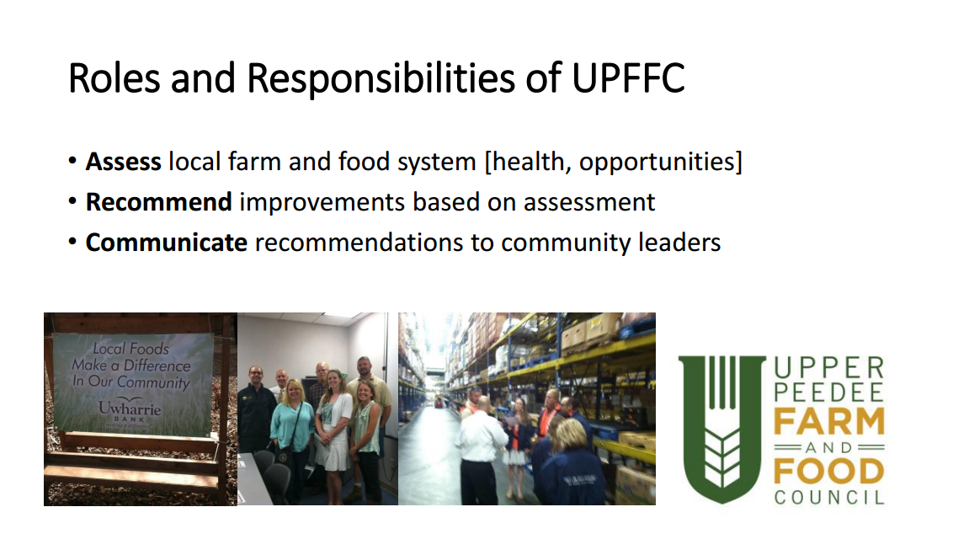

Slide 40
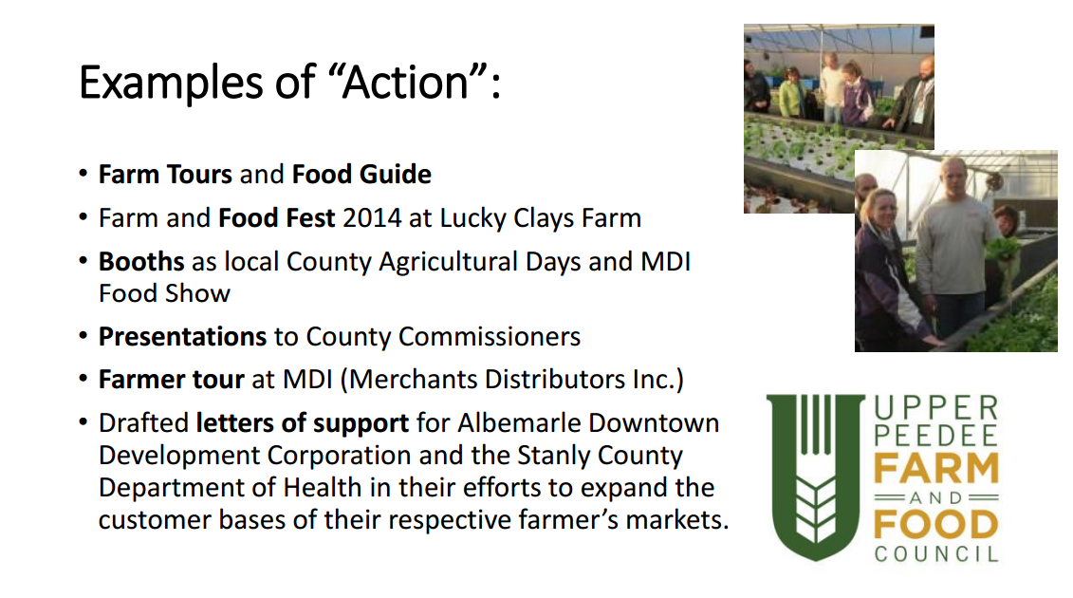

Slide 41
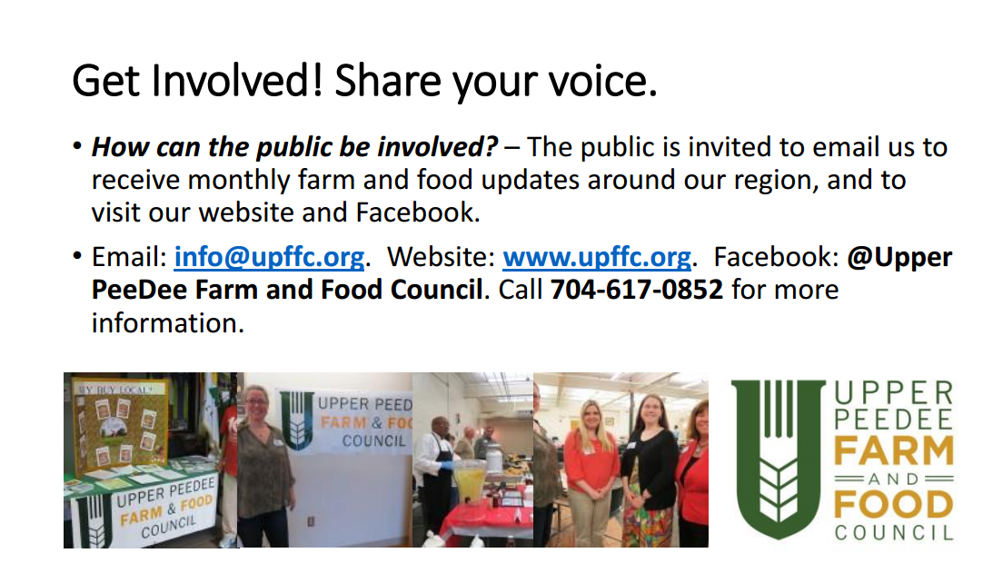

Slide 42
Session Take-Aways
Food councils are examples of the importance, opportunity and benefits of cross-sector collaborations.
Best Practices for Food Councils – 5 years in:
  Diversified leadership is essential for a sustainable food council.
  Food council best practices include having at least part time paid coordination.
Successful food councils create and enliven a space for collaboration…and (sometimes) food councils take action.

Slide 43
Comments
and Questions?

Slide 44
Thank you!
Abbey Piner
Community Food Strategies
apiner@ncsu.edu
Aaron Newton
Cabarrus Farm and Food Council
Erin Brighton
Charlotte-Mecklenberg Food Policy Concil
Shawn Hatley
Upper Pee Dee Food Council
Notes:
*We’ll get logos on here and on intro slide for CFSA, CCE, etc.

Slide 45
structured
Structure + Membership + Charter + Bylaws
independent
government entity
Non-profit
501c-3 organization
Government Appointed
Advisory Board
loose
Community
Member
Network

Slide 46
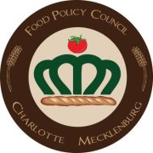

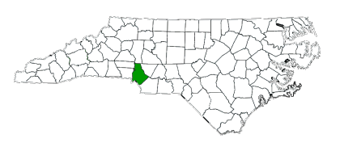
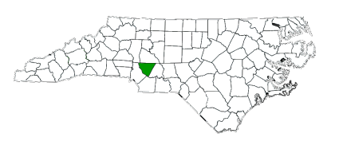

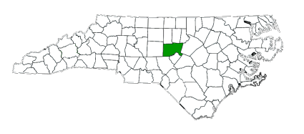
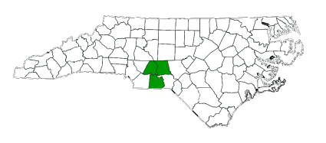
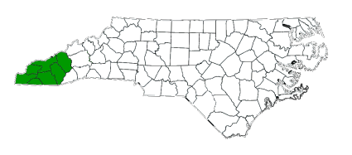
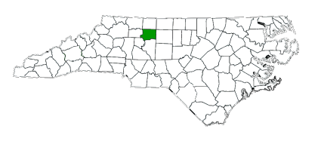
structured
Structure + Membership + Charter + Bylaws
Cabarrus Farm and Food Council *est 2010
Charlotte-Mecklenburg
Food Policy Council *est 2010
Chatham Community Food Council*est 2014
independent
Upper PeeDee Farm and Food Council*est 2012
government entity
Non-profit
501c-3 organization
Government Appointed
Advisory Board
Western NC
Food Policy Council *est 2011
loose
Forsyth Community
Food System Consortium *est 2013
Community
Member
Network

