Slide 1
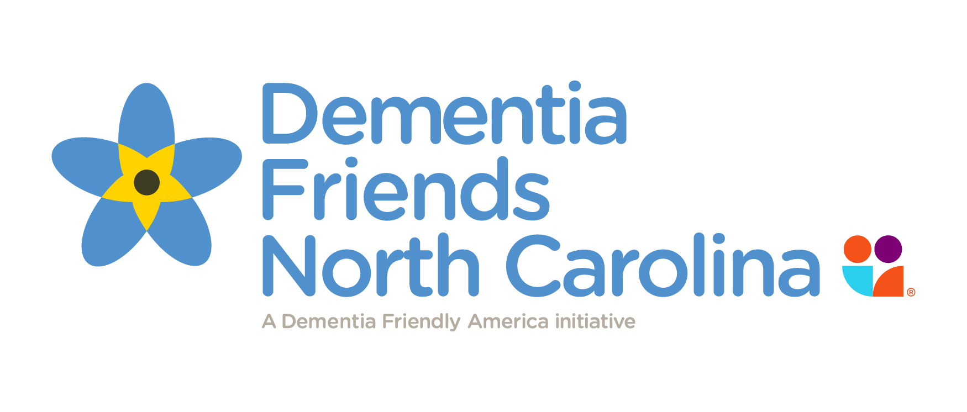
Dementia Friendly Community Planning
Katherine Hebert, Centralina COG Healthy Community Design Specialist
Linda Miller, Centralina Area Agency on Aging Director
Susan Segrest, Central Alabama Aging Consortium Executive Director

Slide 2
Defining Dementia & Alzheimer’s
Dementia: loss of memory and other mental abilities severe enough to interfere with daily life
Alzheimer’s:
Most common form of dementia (60-80% of cases)
Symptoms include- difficulty remembering new information/memories, disorientation, mood/behavior changes, deepening confusion, unfounded suspicions, difficulty speaking, swallowing and walking
Majority of cases occur in person age 65+
No cure, early detection and prevention important

Slide 4
What does this mean to you?
Personally Diagnosed
Caregiver for Family Member
Neighbors Affected
Staff or Co-workers Affected
Citizens/Clients Affected
Others?

Slide 5
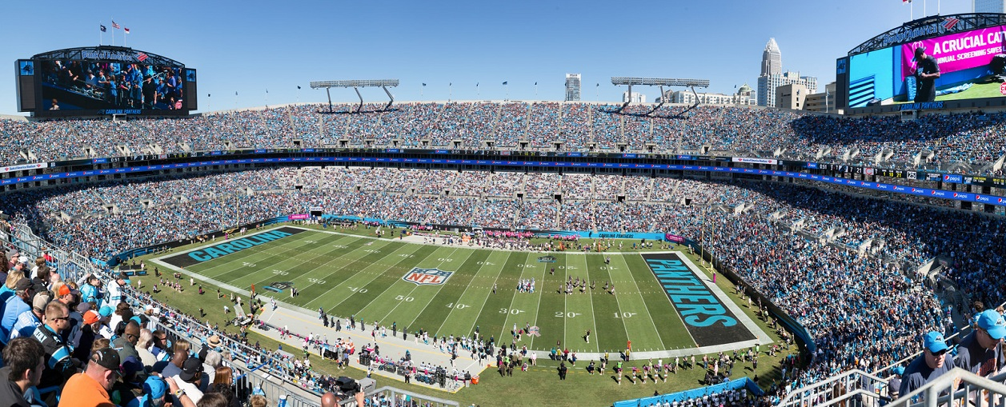
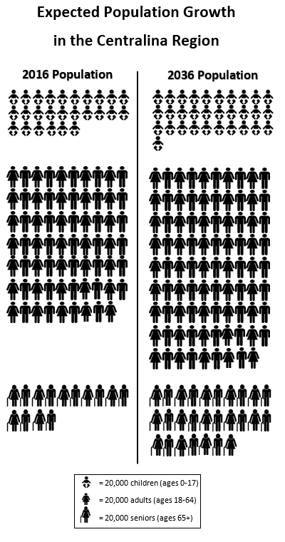
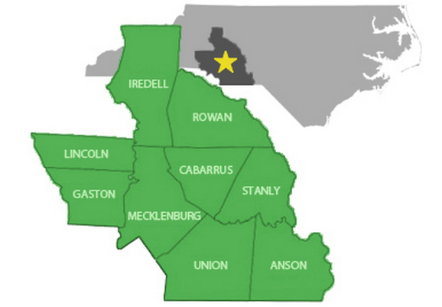
Our Region
+272,900 Seniors

Slide 7
So what’s the difference between Age Friendly and Dementia Friendly anyway?

Slide 8
Age and Dementia Friendly Communities: A Comparison
“Dementia Friendly” (DF) is gaining momentum
Natural extension of “Age Friendly” (AF) and DF community should have all the AF qualities in addition to the unique needs of a DF community
Following comparison is based upon the World Health Organization’s eight domains of age-friendliness alongside the key characteristics of DF communities in each of the eight domains
Reference Dementia Friendly America handout

Slide 9
Age and Dementia Friendly Communities
1. Outdoor Spaces and Buildings
Age Friendly | Dementia Friendly
The city is clean and pleasant. | The physical environment is easy to navigate and includes a variety of landmarks to aid in wayfinding.
There is somewhere to sit and rest, both in buildings and outdoors. | Entrances to places and buildings are clearly visible and obvious.
Roads are safe for pedestrians to cross. | Easy to use street furniture is available and in styles familiar to older people.
2. Housing
Age Friendly | Dementia Friendly
Housing close to services and the rest of the community. | Community-based supports and services help people with dementia maximize independent living.
Home modifications options are affordable and available from knowledgeable providers. | Older adult residential settings offer quality memory care services and supports.
Reference Dementia Friendly America handout

Slide 10
Age and Dementia Friendly Communities
3. Social Participation
Age Friendly | Dementia Friendly
A wide-variety affordable activities is offered to older adults and their companions. | There are organized activities that are specific and appropriate for the needs of people with dementia.
Events are held at times and places that are convenient and accessible to older people. | A befriending service helps people with dementia to participate in community life and provides emotional support.
4. Transportation
Age Friendly | Dementia Friendly
Specialized transportation is available for disabled people. | Transportation escorts are available to help passengers with dementia use public transportation.
Drivers are courteous and sensitive to older riders. | Transit drivers are trained to be sensitive to riders with dementia and how to help them.
Reference Dementia Friendly America handout

Slide 11
Age and Dementia Friendly Communities
5. Respect and Social Inclusion
Age Friendly | Dementia Friendly
Older people are valued and respected by the community. | Community is dementia-aware and puts forth a spirit of support.
Intergenerational activities are part of the community fabric and include older adults. | Staff at businesses learn to recognize signs of dementia and how to support customers with dementia.
6. Civic Participation and Employment
Age Friendly | Dementia Friendly
Workplaces are adapted to meet the needs of disabled people. | Employers’ policies accommodate caregivers’ responsibilities.
A range of volunteer options is available. | People with dementia have meaningful volunteer opportunities tailored to their interest and ability.
Reference Dementia Friendly America handout

Slide 12
Age and Dementia Friendly Communities
7. Communication and Information
Age Friendly | Dementia Friendly
There is reliable and regular distribution of information to seniors, and in accessible formats that they prefer, including seniors who have hearing or vision loss. | There is work to break down the stigma of dementia, especially seldom heard communities (such as some ethnic minorities).
Seniors are kept connected to news, events and activities. | Specific outreach to people with dementia and their caregivers keeps then connected and informed of social activities and services.
Reference Dementia Friendly America handout

Slide 13
Age and Dementia Friendly Communities
8. Community and Health Services
Age Friendly | Dementia Friendly
An adequate range of health and community support services is offered. | Early access to diagnosis and post-diagnostic support exists for patients and caregivers.
Home care services include health, personal care and housekeeping. | Dementia-focused programs such as Dementia Friends and community trainings can leverage the broader community in providing a support network.
All staff is respectful, helpful and trained to serve older people. | At-home services help people with dementia adjust to changing needs.
Reference Dementia Friendly America handout

Slide 14
Dementia-Capable North Carolina
NC wrote their first strategic plan to address Alzheimer’s disease and related dementias (Completed March 2016)
Framing the Plan:
Raising awareness about dementia and transforming attitudes
Having supportive options that foster quality of life
Supporting caregivers and families touched by the disease
Promoting meaningful participation in community life
Reaching those who are underserved

Slide 15
Dementia-Capable North Carolina
2016-2017 Plan Roll Out across NC
Selected sites to serve as pilots- including Charlotte
Each pilot had a “Kick Off” event and focus group to gather local input
Focus on using Dementia Friendly America Toolkit
NC4A purchased Dementia Friendly state license for awareness outreach
Attending other “age friendly” planning efforts within Centralina region to ensure that there is a “dementia friendly lens”

Slide 16
Promoting Dementia Friendly Communities
Do your PART

Slide 17
Central Alabama Aging Consortium – CAAC
Serving 3 counties in Central Alabama
Capital City of Montgomery
http://centralalabamaaging.org/ (Updated web-site to include DFA Tab)
Funding
2015/16 - $50,000 State Grant
2016/17 - $100,000 State Grant
2017/18 - $100,000 State Grant

Slide 18
Communities commit to do their PART – Local Officials
Partnerships
Academic Education
Resources
Training
Year 1 – Developed logo, face book page, revised web-site, DFA business decal, promotional items, partnerships, Care to Plan web-based tool, education in schools, community education, including VDT;
Year 2 – Finalized CtP web-based tool, Dementia Resource Guide, DFA business, partnerships, First Responder Training, education in schools, community education, mini-grants;
Year 3 - Began in July 2017 – Revise and re-print resource guide, continue education in schools, businesses, and community, physician education, partnership development, issue RFP and mini-grants – Writing grants to sustain

Slide 19
Partners (Partial List)
Dementia Friendly America (A4A and other national partners)
State Unit on Aging - Alabama Department of Senior Services (ADSS)
Local Officials – Mayors, County Commissioners, Police Depts., Planning Commissions
Alabama Law Enforcement Agency (ALEA)
First UMC Dementia Respite Program
Local Housing Authorities
Montgomery Police Department
Jones School of Law – Faulkner University
Banks
Mini-Grant Recipients – Including Healthcare providers – clinics, physicians
Alzheimer’s of Central Alabama (ACA) , Resources, & Services (AERS)

Slide 20
Academic Education
Troy University – Virtual Dementia Tours for Nursing Students and Social Work Students assist with classes for high school students
Auburn University-Montgomery & Virginia College – Virtual Dementia Tours for Nursing students & former participants come back and help with the VDT the next semester
Tools/promotional items/educational materials
Loveless Academic Magnet School – 1st School - 9th Grade
Current School – Vaughn Road Elementary – 4th – 6th graders

Slide 21
Resources
Care to Plan Alabama
CAAC web-site (redesigned with DFA Link)
DFA Facebook Page
Memory Screenings
Virtual Dementia Tours (P. K. Beville)
DETA Training Materials
Dementia Friendly America
Alzheimer’s Foundation of America
Alzheimer’s Association
Dementia Resource Guide

Slide 22
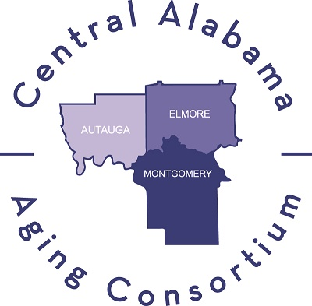
Training
Police and Sheriff’s Departments
Montgomery County Office of the District Attorney
Prime South Bank – 1st DFC Business
Professionals & Caregivers – Lunch & Learns, Conferences, VDTs
2018 DFA conferences in 4 area of the state – Offering Caregiver Scholarships for each event

Slide 23
You CAN make a difference in your community!
Help make your community one where those with dementia can live and thrive!
Memory Cafes Law Enforcement Training Gismo Gadgets
Art/Music Intergenerational Relationships Sensitivity Training-VDTs
Healthy Brain Education First Responder Training Adult Day Care
Caregiver Training Elder Abuse Prevention/Reporting Respite
Falls Prevention Chronic Disease Self-Management Resources
Support Groups Physician Training Dementia Friendly Businesses
Faith-Based Organizations, including churches

Slide 24
Contact Information:
Katherine Hebert
Healthy Community Design Specialist
Centralina Council of Governments, Charlotte, NC
khebert@centralina.org
Phone: 704-348-2708
Linda Miller
Director
Centralina Area Agency on Aging, Charlotte, NC
lmiller@centralina.org
Phone: 704-348-2712
Susan Segrest
Executive Director
Central Alabama Aging Consortium, Montgomery, AL
Susan.Segrest@adss.alabama.gov
Phone: 334-240-4680

