Slide 1
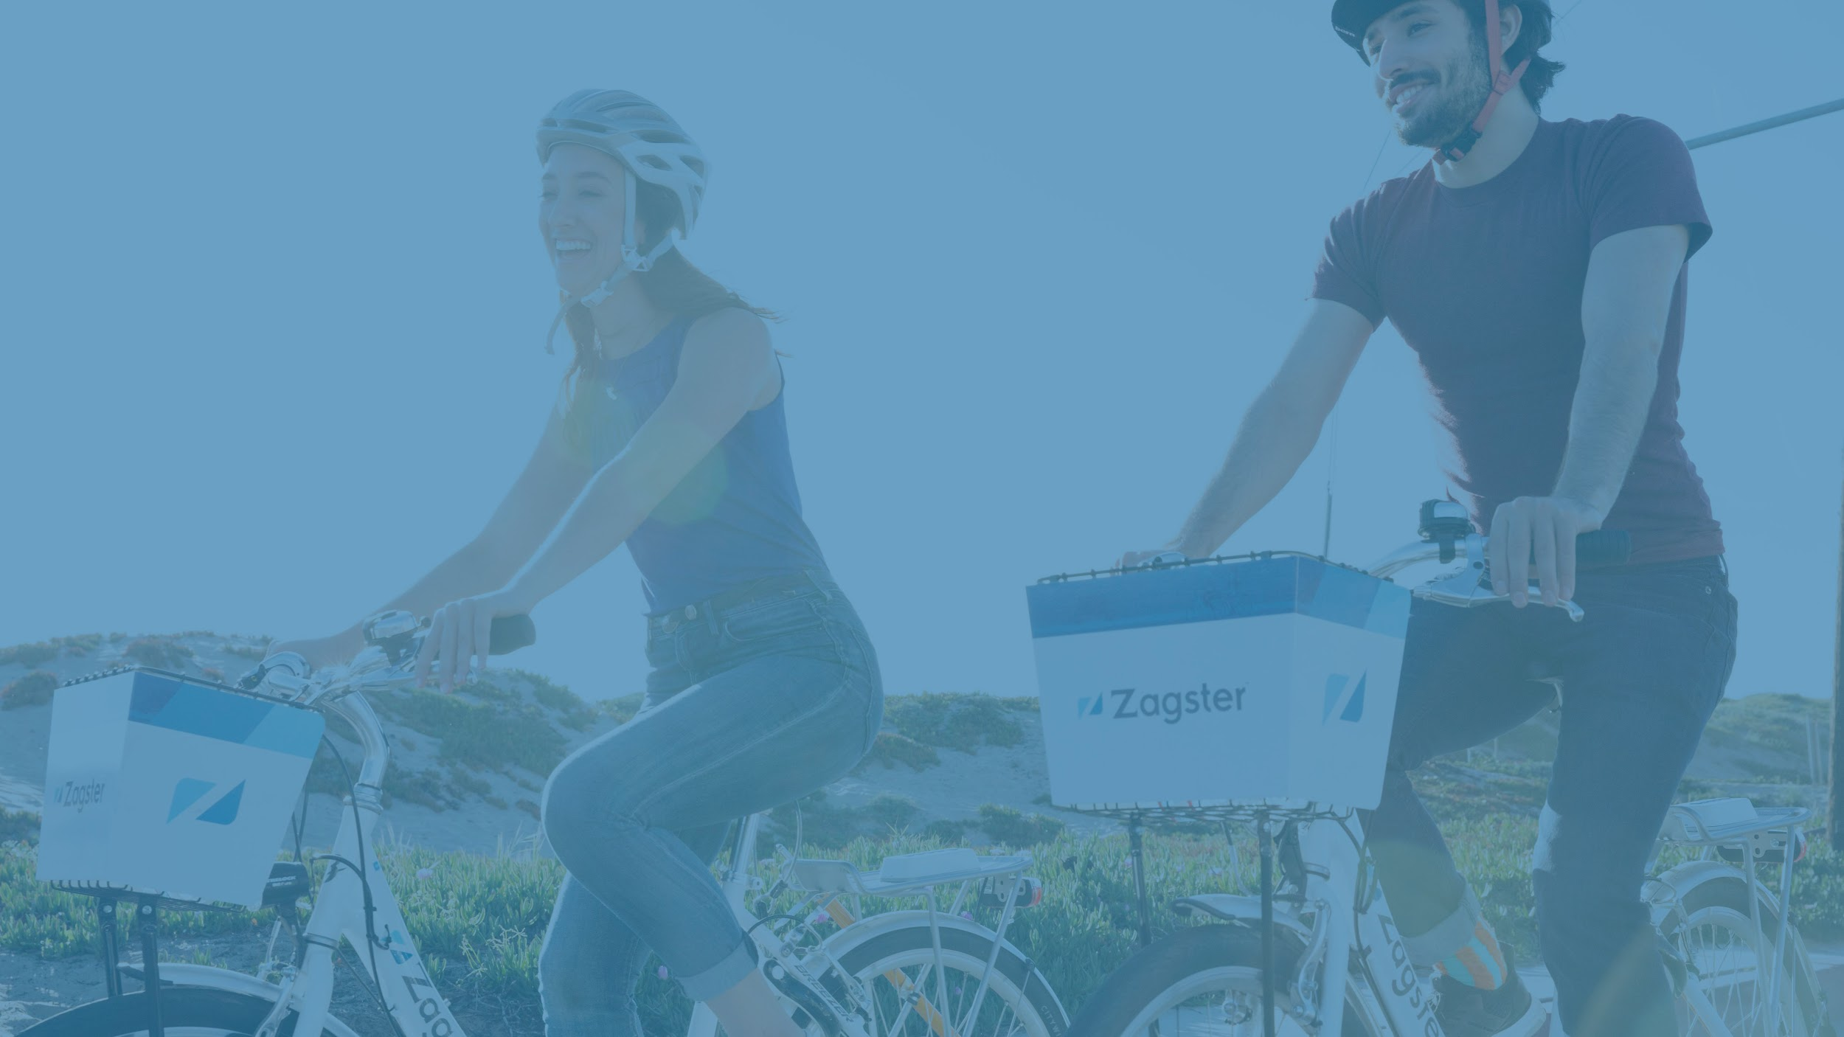
Go Gaston Bike Share
October 10, 2018
Copyright © 2018 by Zagster, Inc.

Slide 2
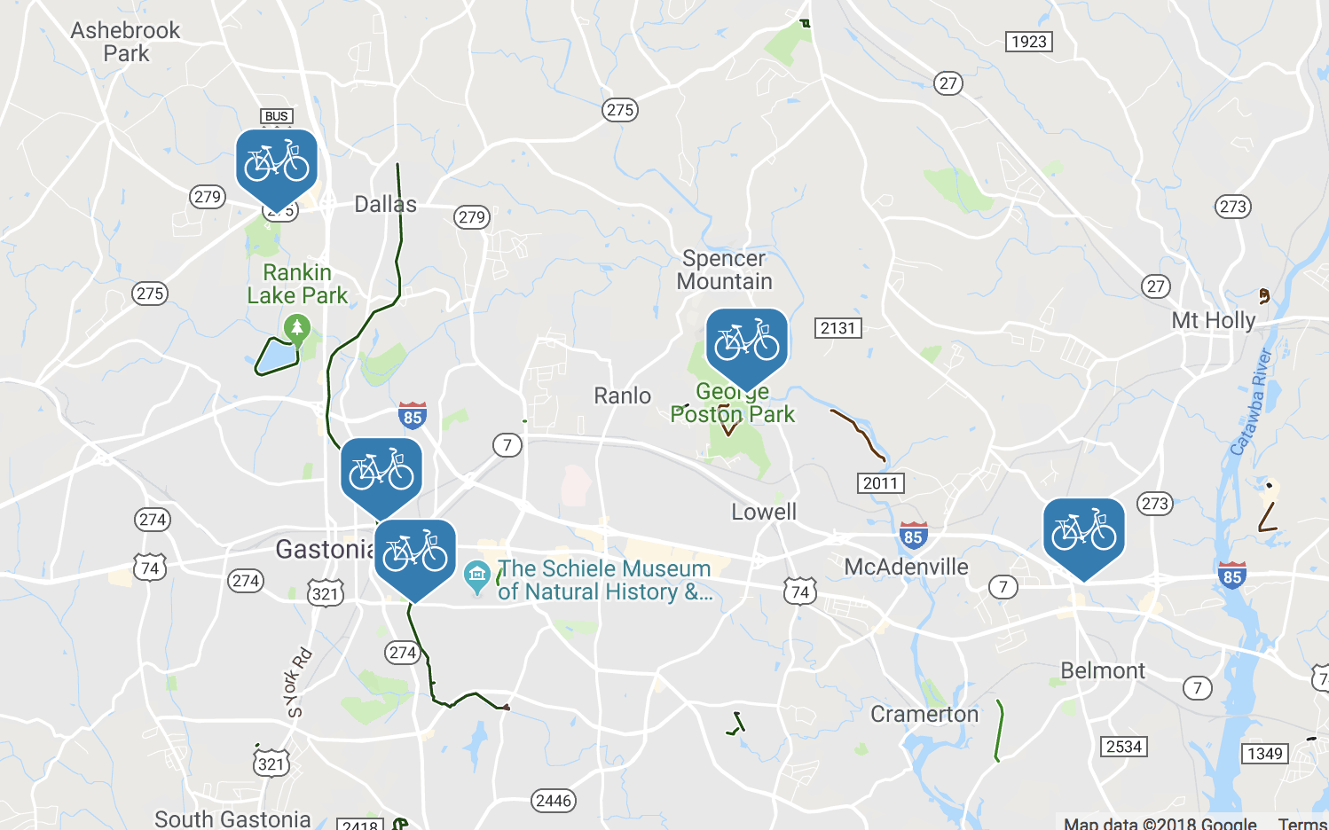
Program Overview
Founding Sponsor:
Launch Date: May 27, 2017
Station: 5
Bikes: 22
Trips Taken: 1,890
No. of Members: 1,011

Slide 3
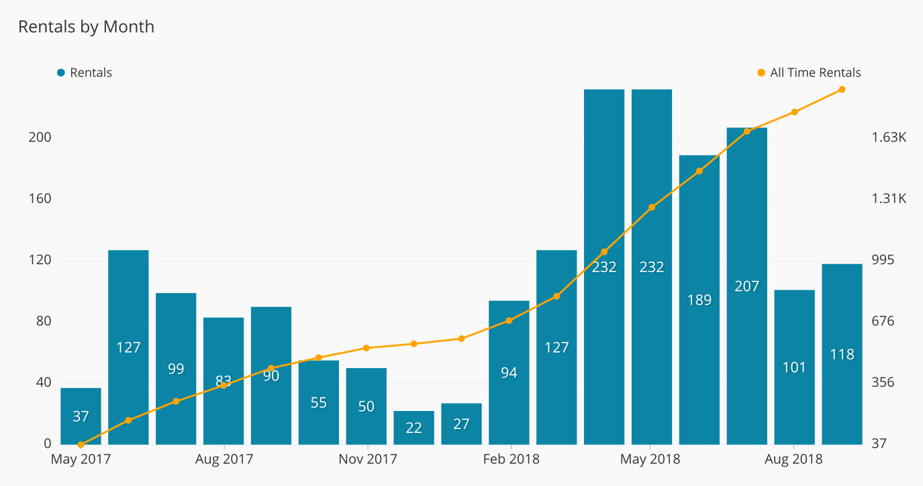
Ridership has grown 96% Year-over-Year
147
Avg Rides/Month
2018
1890
Total Trips
75
Avg Rides/Month
2017

Slide 4
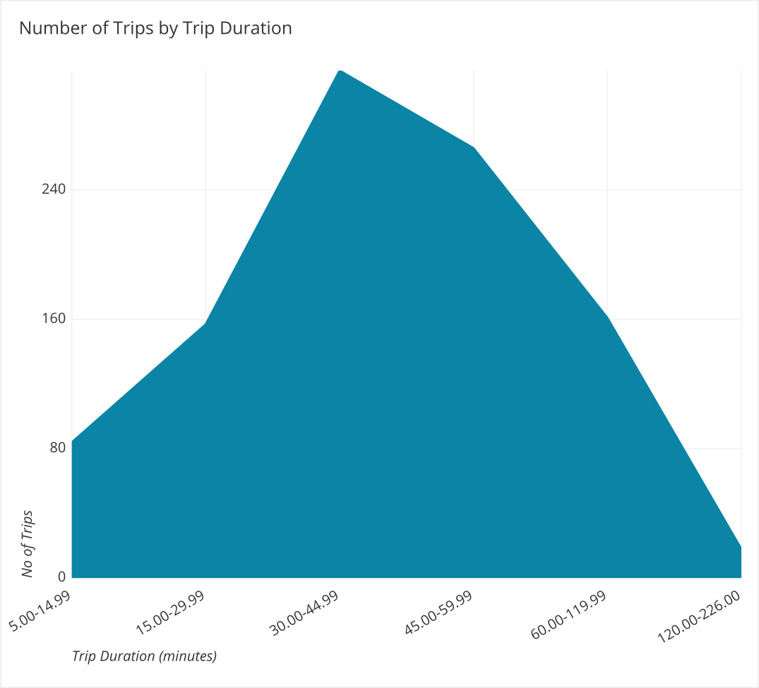
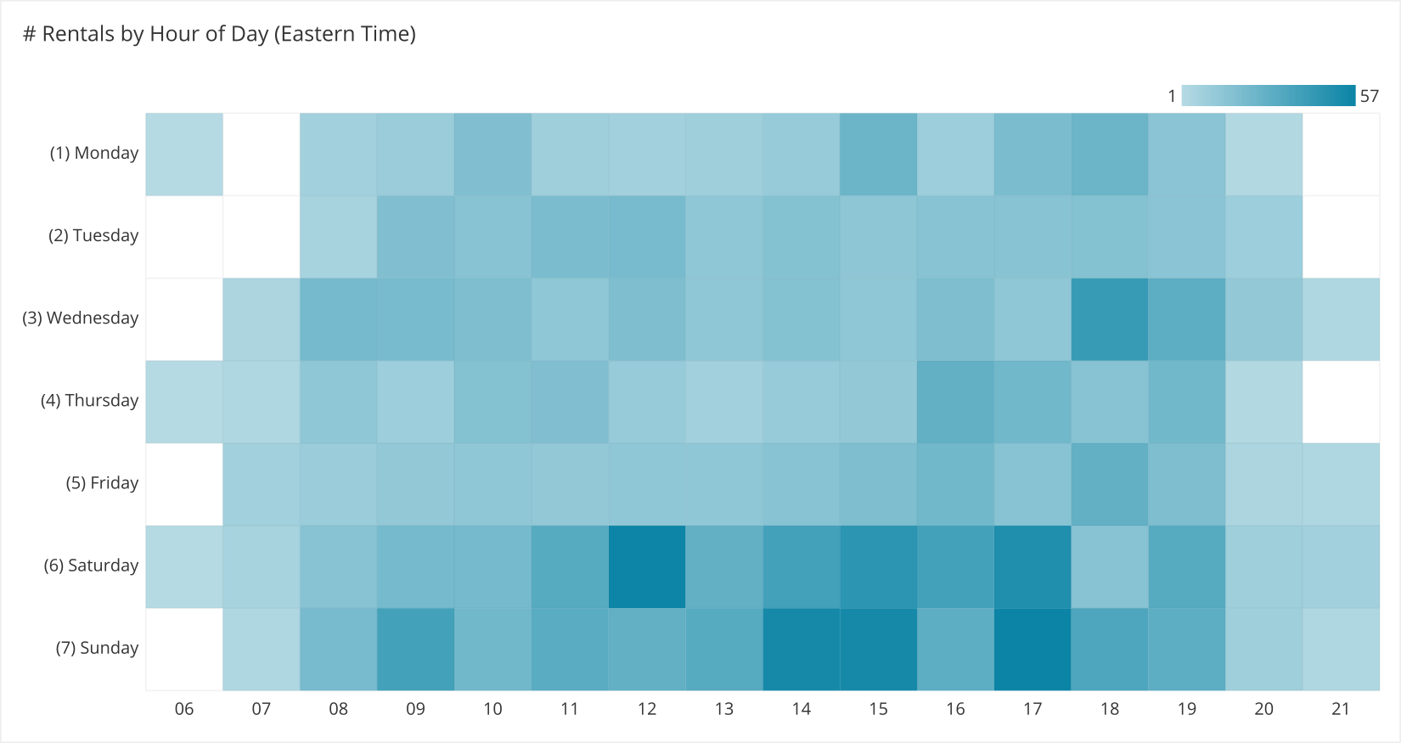
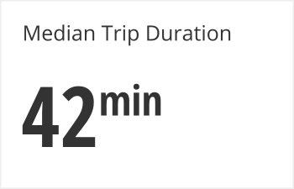
Recreational Riding
Peak ride times -
Saturday and Sunday Afternoons

Slide 5
Impact on Community Health

Slide 6
Top Users & User Feedback
TOP USERS
Select User Feedback
First Name | # of Rentals
Kay | 177
Stesy | 52
Joshua | 33
Althea | 28
David | 26
“So very easy to rent a bike so I could keep up with my daughter as she ran the greenway. So much easier than loading the bike up on the car.“ - Michelle W.
“I had so much fun riding bikes with my girlfriend and it's all thanks to you!” - Daniel M.
“Rental process was very simple. Was able to enjoy an easy ride in the park with my daughter and granddaughter. Have already recommended to friends.” - Roberta A.

Slide 7
Vision for Growth

Slide 8
As trail network gets built out, Go Gaston wants to expand into downtown areas like Belmont and Mt. Holly.
The vision is that the trail network serves as a bike highway, while downtown destinations enable recreational riders to ride into town.

Slide 9
Happy Riding
www.zagster.com
Notes:
Meet with transportation partners - to see what type of committment they are willing to commit
SUBSIDIZED - Setting up meeting with
Setting up a meeting with transportation parking services
Student Rec Center
BY END OF SUMMER LIST OF THINGS TO DO
Year end closing budget - July 31 - so they will have better idea of budget.
See if they can add more.
share approved through the senate - to look
Proposal to renew as is - renewal with 25 more bikes - renew with 50 more bikes
Main complaint - 10-12 bikes out of comission
Hopefully the ERL will help
More regular maintenance - solution
Have the missing bikes been replaced?
YES
Follow up when Fleet coordinator if replacement bikes have been there.
STUDENT AMBASSADOR?
If there is a volunteer, that would be great. We can look into making them a part-time employee .
Maybe somebody from Austin’s committee.
Riverside has not reached out to.
Marty showed mayor and others program
First Wednesday of each month - 12 pm
FOLLOW UP WITH FLEET -

