Slide 1

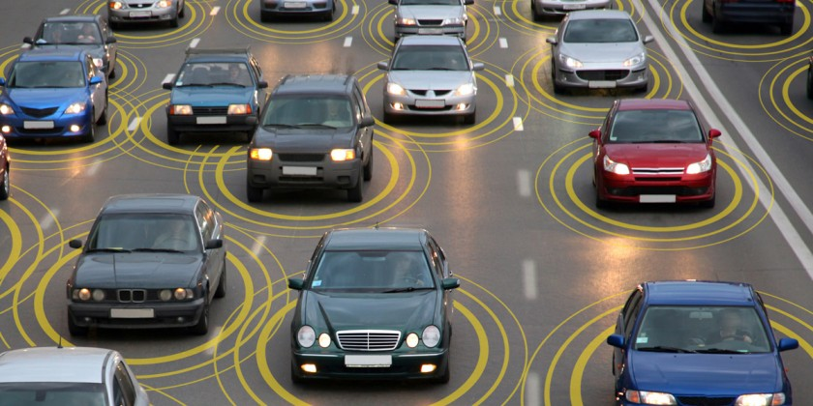
Autonomous & Connected Vehicles
Task Force
Kick-off Meeting
March 2, 2018

Slide 2



A Special Thanks to our
Sponsors & Partners

Slide 3
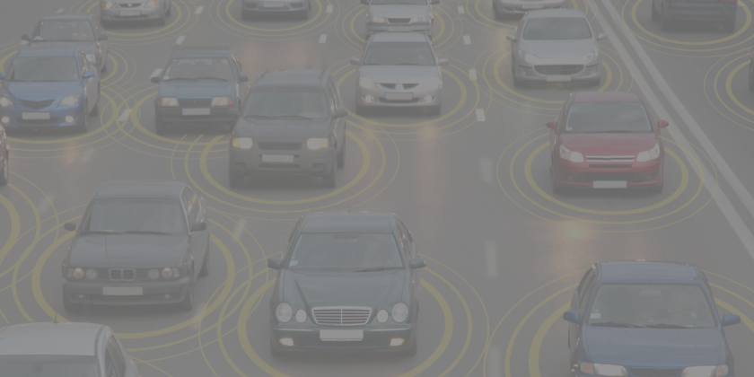
Setting the Context
What's been done so far
Taskforce Role

Slide 4
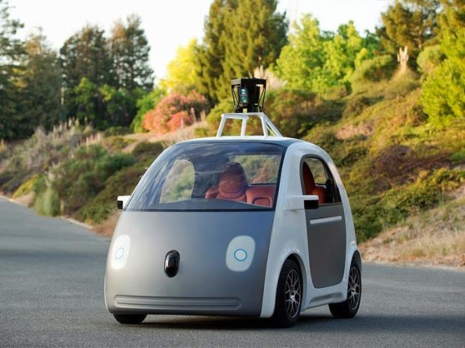
Self-Driving Vehicles
Autonomous car
  Cameras and sensors to detect other vehicles and obstacles
    Scaled up from recently emerged safety/driving technologies
    Leverages ultra-detailed maps
    Software learns from events
  Autonomous versus Driverless Vehicles
    Also, in the future: VMT ≠ VMD
  Mixed Fleet in 2020s; moving towards Dominant Fleet in the 2030-2040s (potential requirements)
  AV Implications for Transport Planning
https://www.vtpi.org/avip.pdf
Notes:
First we have to define the key components of this changing technology
Autonomous cars are those that are not reliant on connectivity – but rather have cameras and sensors to detect other vehicles and obstacles –they are designed support driving, or ultimately navigate roadways independently

Slide 5
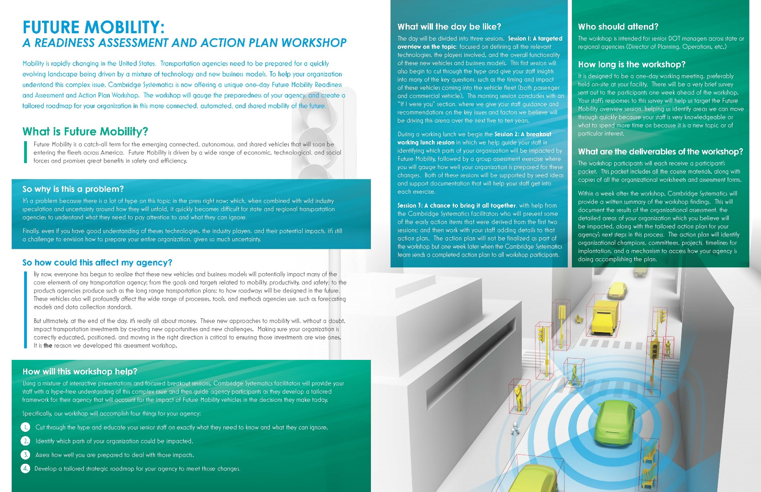
Connected Vehicles
Vehicles can communicate with each other, roadside devices, other users
  All equipped vehicles
  Intersections
  Pedestrians/cyclists (smartphone)
NHTSA has published multiple rules on CV (latest was Sept 2017)
3 CV pilot projects underway
  $42 million from FHWA
Notes:
CV are Vehicles can communicate with each other, roadside devices, other users
VDOT has developed a Connected Vehicle plan, which is why this plan focuses on the AV aspects only.

Slide 6
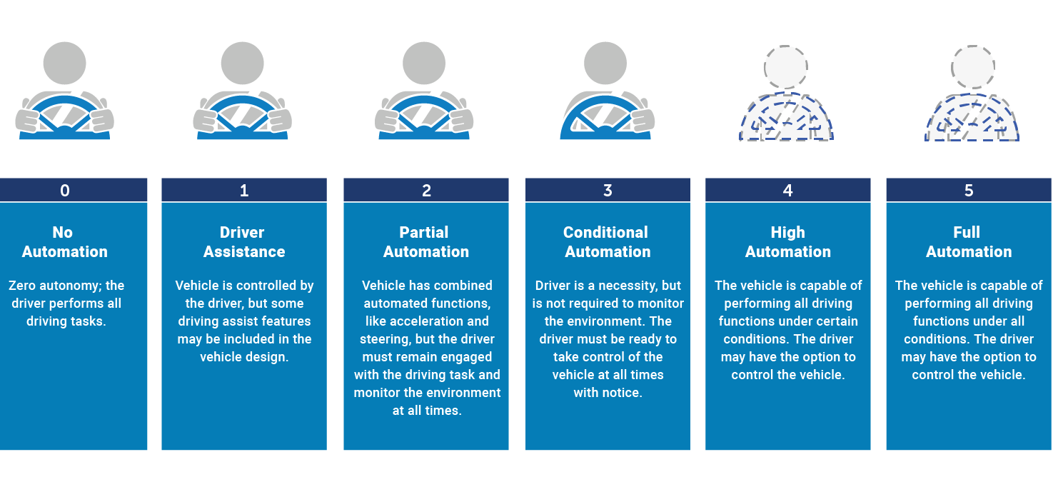
NHTSA/SAE Classification System for Vehicle Levels of Automation
Notes:
The Society of Automotive Engineers and NHTSA have defined 6 levels of automation, from 0-5. We don’t have time to go into the details, but come see me later if you want more information .
BACKUP
Level 0
No Automation
None
All driving functions of the vehicle.
Level 1
Driver Assistance
Includes features such as adaptive cruise control or lane centering to independently assist the driver.
Responsible for all core driving functions.
Level 2
Partial Automation
Conducts some parts of the driving task, such as steering, acceleration, and deceleration.
Responsible for monitoring the external driving environment and ready to take control with or without warning from the system.
Level 3
Conditional Automation
Performs most driving functions and monitors the driving environment. May request human driver to intervene for specific driving tasks.
Must remain ready to take control and respond appropriately to the AV systems’ request to intervene.
Level 4
High Automation
Conducts all driving tasks and monitoring within a pre-defined environment designed for specific situations, such as a defined-route AV shuttle and/or certain weather conditions. No human-facing controls required.
Human does not need control vehicle in its intended AV environment, but would need to drive the vehicle outside of its intended environment.
Level 5
Full Automation
Conducts all driving functions under all environments without a human driver.
Human provides destination or navigation input but does not control the vehicle at any point. Designers may include features such as steering and speed control to allow human operator when system is not engaged.

Slide 7
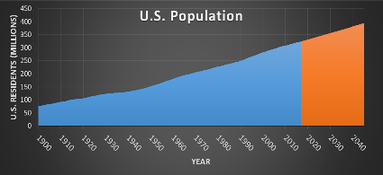



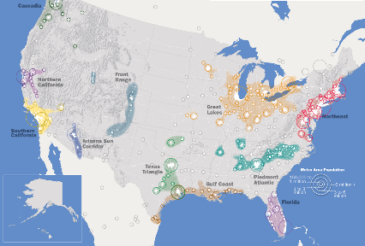




CONVERGING TRENDS ARE SHAPING MOBILITY
Population
Demographics
Technology
Americans are Living Longer
By 2045, the number of Americans over age 65 will increase by 77%.
Integration of Connected & Automated Technologies
ACTUAL
PREDICTED
Introduction of Shared Service Platforms
Population expected to grow by 70 million in next 30 years
About one-third have a disability that limits mobility.
Advancements in Energy Storage Technology
Millennials are Connected & Influential
Deeper Application of Big Data
There are
73 million Americans aged 18 to 34.
Faster Processing Speeds at Decreasing Cost
75% of population concentrated in 11 Megaregions
They drove 20% fewer miles in 2010 than at the start of the decade.
Notes:
Why this discussion now?

Slide 8
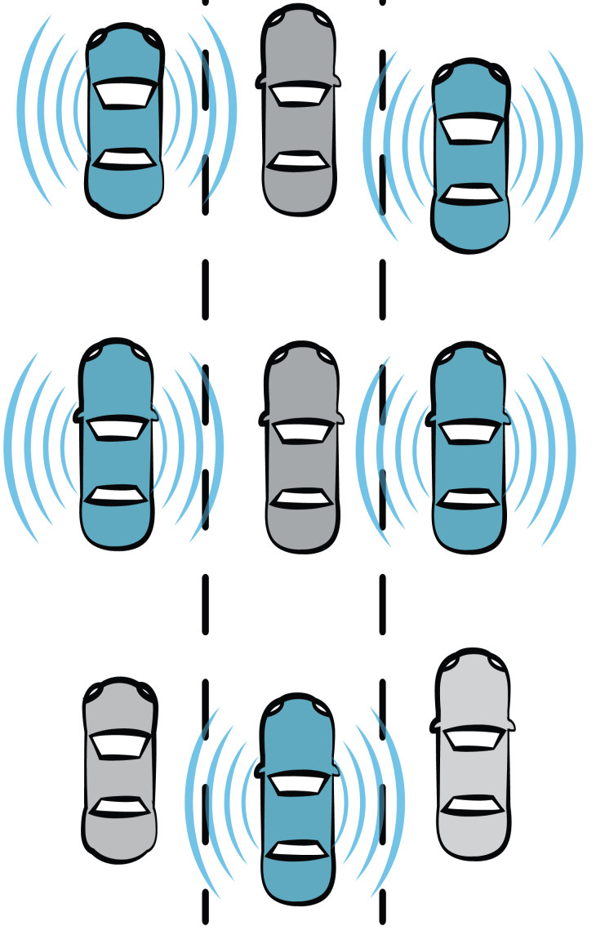
Connected and Self-Driving Vehicles System - Possible Benefits
Safety | Mobility | Energy
When the majority of the fleet is both connected and automated > significant decreases in crashes > significant increases in safety and reliability
Vehicle spacing on roadways will be safely reduced on a large scale, reducing congestion and creating more throughput
Benefits in all major areas: mobility, safety, and environment… and perhaps others… reduced parking demand, productivity, relaxation, and ???
Notes:
We know there are expected benefits – greatest of these are when the safety benefits, as well as mobility and economic impacts become significant.
Crash reduction
Capacity increases in current systems with no new ROW required
Cost savings running through many industries, possibly starting with freight
Add “sharing economy” impacts and the potential for disruption is enormous

Slide 9
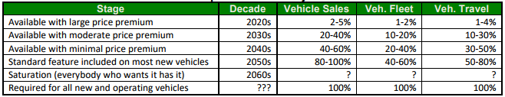
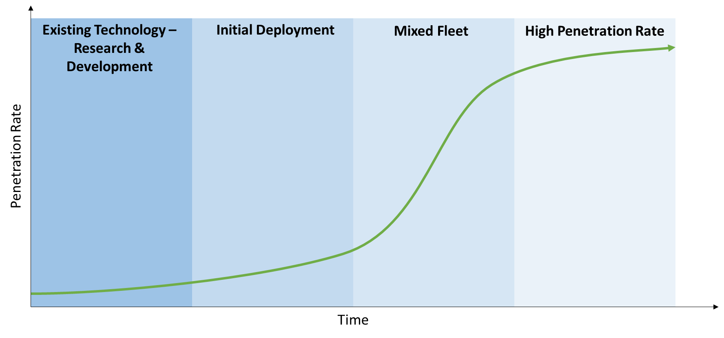
Predicting the future is hard…
Source: Victoria Transport Policy Institute, Autonomous Vehicle Implementation Predictions, 2017
Notes:
James Kuhr, Center for Transportation Research - UT Austin
Technology prediction, seem to be Coalescing around a 2021 commercially available start date, but many issues remain to resolve
https://www.slideshare.net/ctrutaustin/connected-and-autonomous-vehicles-the-enabling-technologies

Slide 10
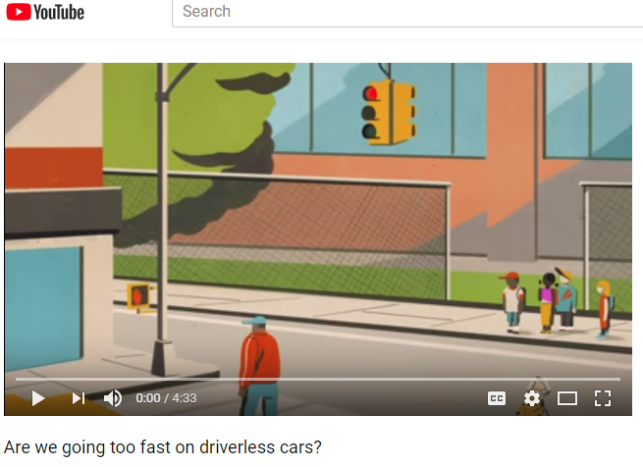
Science Magazine, December 14, 2017
Confirming what we thought
Lots of considerations
Lots of unknowns

Slide 11
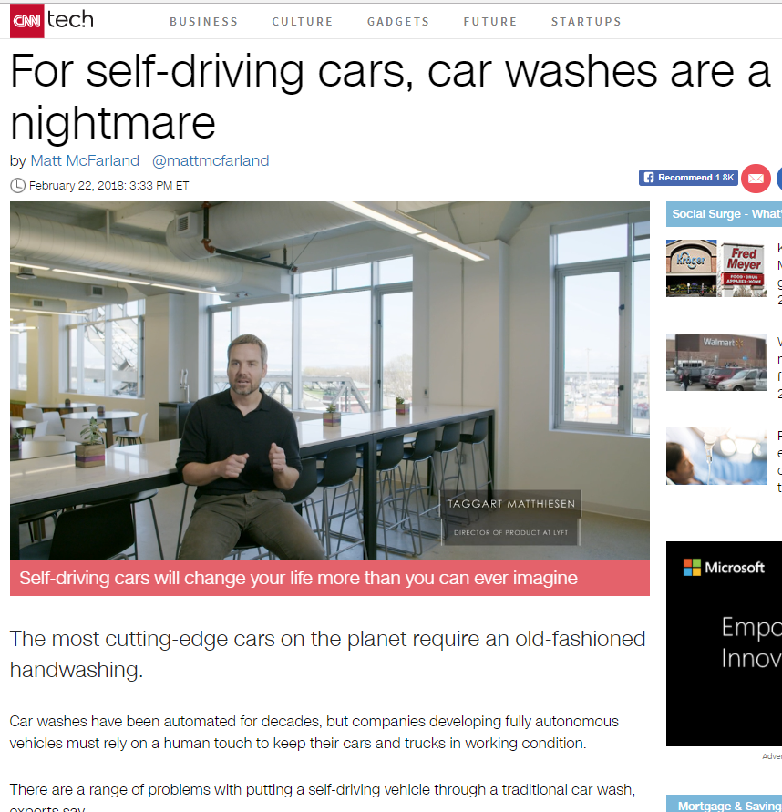
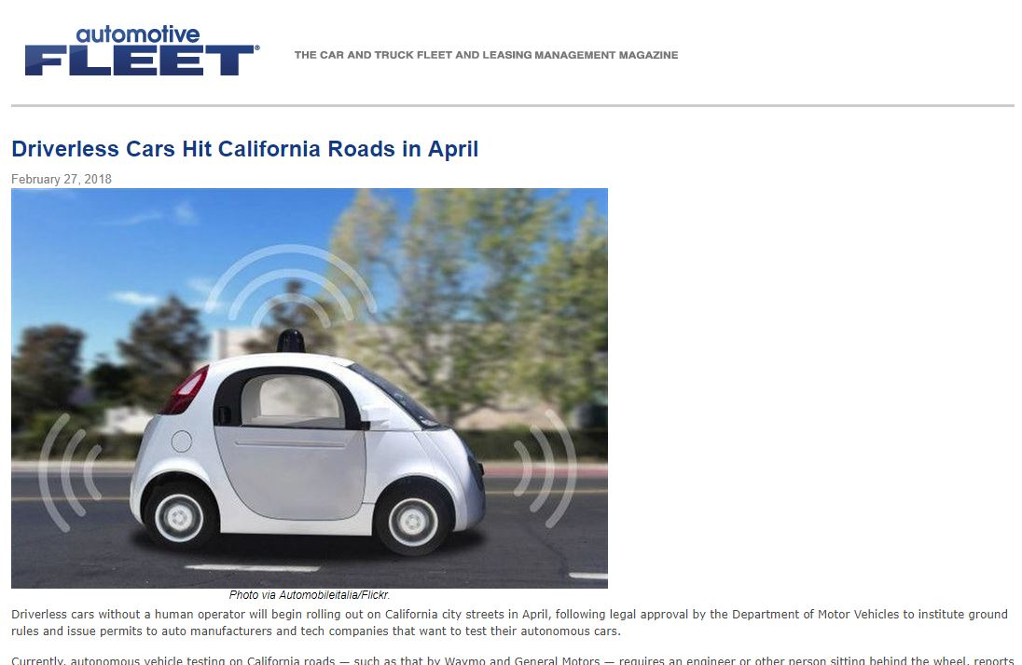
From Imminent Impacts to Mundane Considerations

Slide 12
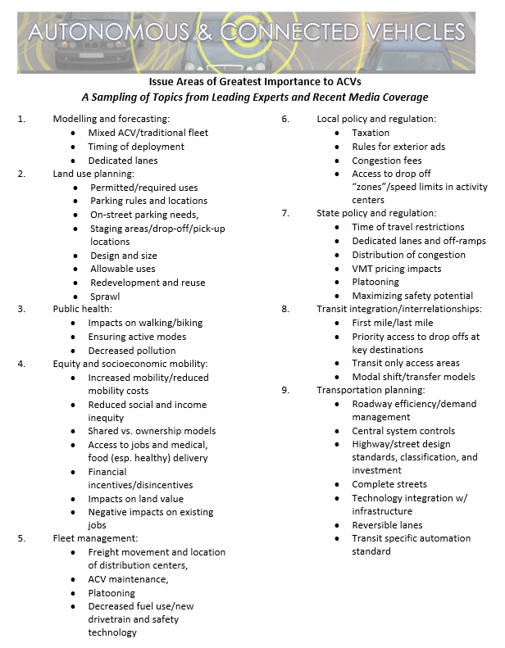
What’s Been Done Here, Given So Many Questions?
Notes:
Staff did a non-scientific cataloging of research and presentations to better understand the breadth and depth of questions as we developed a 3-Workshop Series in the Fall of 2017

Slide 13
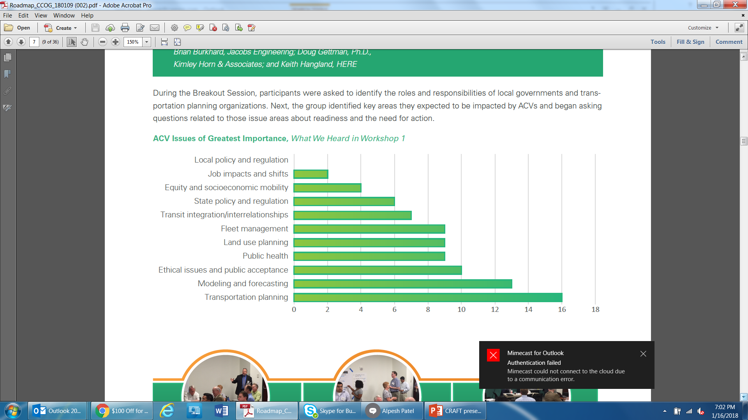

Challenges Facing Multiple Agencies & Organizations
AVs will impact almost everything across public agencies and the private sector, including regional issues such as…
Transportation Planning
Traffic Engineering and Operations
Transportation Capital Investment
Public Transportation
Data Management and Security
Non-motorized Transportation
Notes:
Participants connected larger issues to local roles and perspectives- several “ahah moments” about how their roles relate to these emerging changes

Slide 14
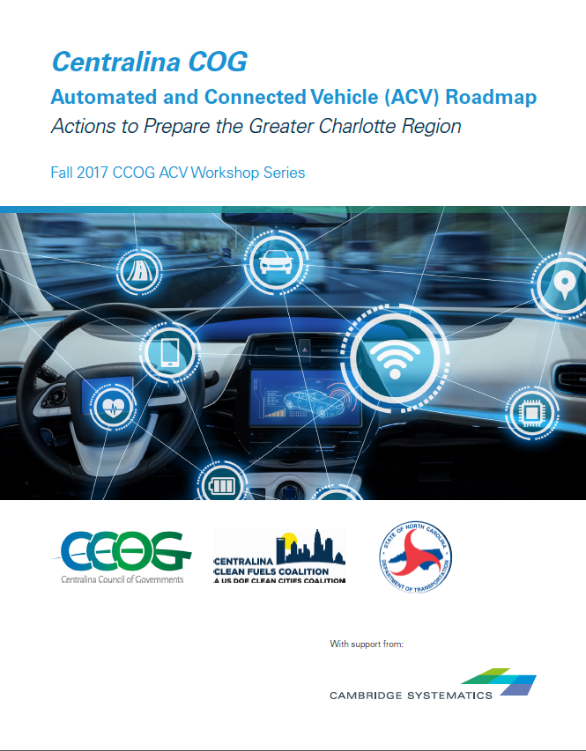
Automated and Connected Vehicle (ACV) Workshops -
Actions to Prepare the Greater Charlotte Region
Workshop concept sprung from Regional Freight Mobility Plan
50+ participants per workshop
Leading researchers, industry experts, best practice
1st region based dialogue on technology preparation, obstacles, solutions in NC
Roadmap with actionable steps
Transferable concept for state and national peers
Notes:
Task Force – time bound – we continue for as long as the group agrees to continue

Slide 15
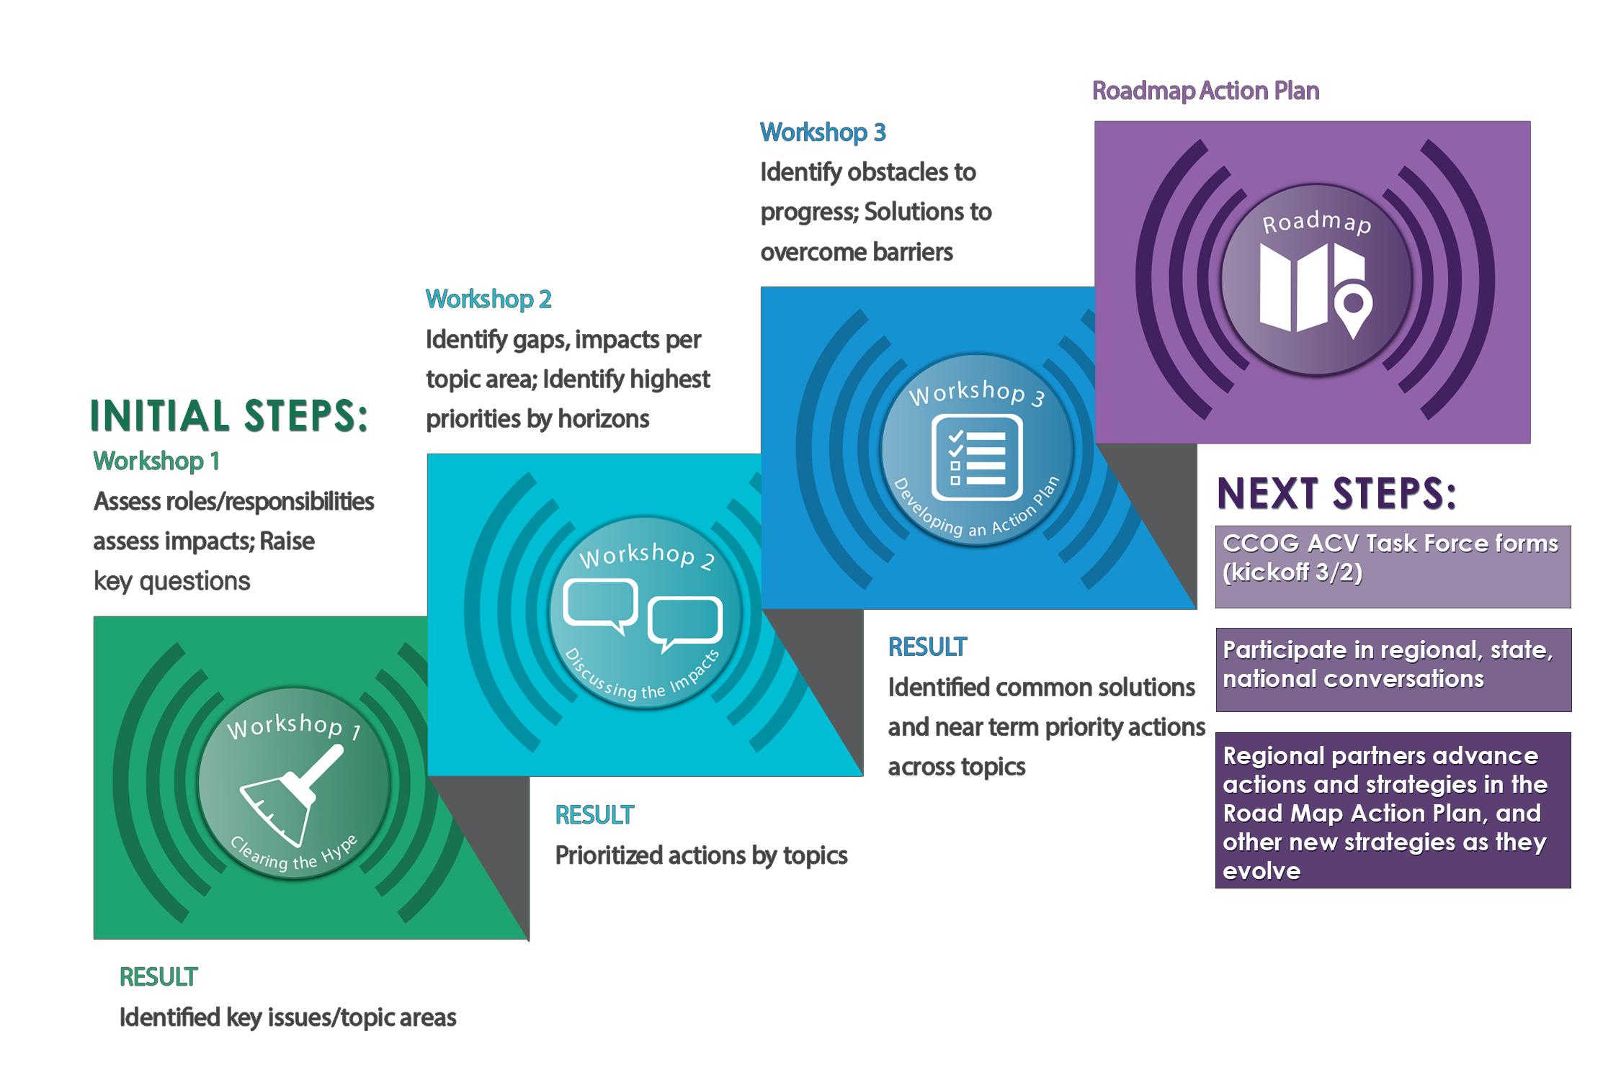
Notes:
Highlight national vs regional perspective - tell the story of local perspective and priorities – where and how local leaders can engage – confirm value of workshops and future Task Force

Slide 16

Centralina Council of Governments (CCOG) Autonomous & Connected Vehicles Workshops Overview
Workshop 1: Clearing the Hype
  An educational session on what is coming in the next 5-10 years and NCDOT’s early strategy and response
Workshop 2: Discussing the Impacts
  How will ACVs impact our work and how we reach our long-range goals and objectives?
Workshop 3: Developing an Action Plan
  Determine key steps the region can take to prepare for and make the most of this game-changing technology
Notes:
Workshop 1: Clearing the Hype- August 23rd
An educational session on what we know today and what is coming in the next 5-10 years. Participants will leave with a raised awareness, education, and a clearer sense of the emerging and disruptive issue of Automated and Connected Vehicles or ACV and begin to grasp its growing near-term impact within transportation. Participants will learn about NCDOT’s early strategy and response to this impeding change and be exposed to both presentations and a panel discussion which summarize related research, legislation, and actions taken at the national and state levels, including other State DOTs and MPOs.
Workshop 2: Discussing the Impacts -September 20th
How will ACVs impact our work and how we reach our long-range goals and objectives in the areas of public transportation, transportation planning, land use, modeling and forecasting, fleet services, etc.
Workshop 3: Developing an Action Plan - October 25th
Determine key steps our region can take to prepare for and make the most of this game-changing technology by incorporating input from government, business, economic development and academia interests

Slide 17
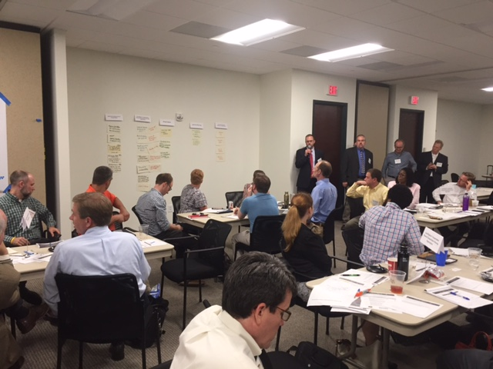
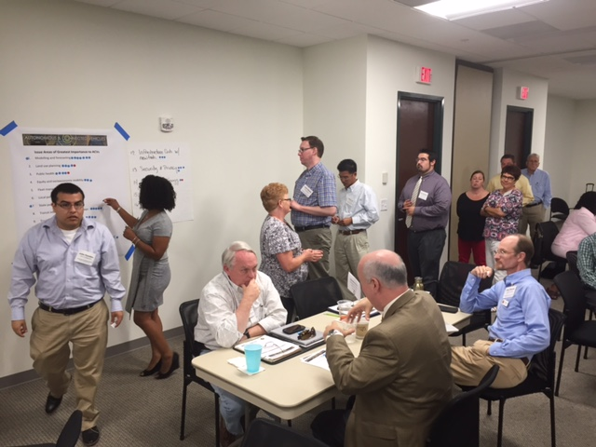
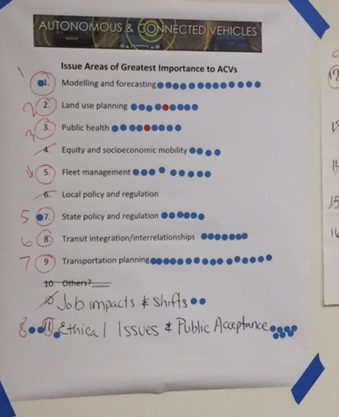
ACV Workshop 1
Workshop 1: Clearing the Hype
  An educational session on what is coming in the next 5-10 years and NCDOT’s early strategy and response
Notes:
Workshop 1: Clearing the Hype- August 23rd
An educational session on what we know today and what is coming in the next 5-10 years. Participants will leave with a raised awareness, education, and a clearer sense of the emerging and disruptive issue of Automated and Connected Vehicles or ACV and begin to grasp its growing near-term impact within transportation. Participants will learn about NCDOT’s early strategy and response to this impeding change and be exposed to both presentations and a panel discussion which summarize related research, legislation, and actions taken at the national and state levels, including other State DOTs and MPOs.
Workshop 2: Discussing the Impacts -September 20th
How will ACVs impact our work and how we reach our long-range goals and objectives in the areas of public transportation, transportation planning, land use, modeling and forecasting, fleet services, etc.
Workshop 3: Developing an Action Plan - October 25th
Determine key steps our region can take to prepare for and make the most of this game-changing technology by incorporating input from government, business, economic development and academia interests

Slide 18
Workshop 1 Results –
ACV overview and education
Workshop 1 Included a series of educational presentations to solidify a baseline of understanding of ACV issues, definitions for all participants:
ACVs 101: Mark Jensen of Cambridge Systematics
Impacts and Timing of Adoption of ACVs Panel Discussion:
  Brian Burkhard, Jacobs Engineering
  Doug Gettman, Ph. D; Kimley Horn & Associates
  Keith Hangland, HERE
ACVs in 25 years – Sam Van Hecke, Cambridge Systematics
National and State Efforts to Prepare for ACVs: Kevin Lacy, NCDOT
Breakout Session – We identified roles and responsibilities of local governments and transportation planning organizations
Notes:
ACVs 101: Mark Jensen: Definitions and explanation of AVs and CVs and their operations and functions and how each interacts with the environment, infrastructure and people. Introduction to potential benefits and drawbacks to the transportation system, urban environment, and communities.
Impacts and Timing of Adoption of ACVs Panel: This expert panel will present their view of the next 5-10 years as it relates to the adoption of ACVs and the impacts that communities could begin to see take place.
ACVs in 25 years -Sam Van Hecke: - Envisioning the Long Term
National and State Efforts to Prepare for ACVs – Learn about the activities and focus of national and state transportation agencies as they prepare for ACVs.
Breakout Session – Identifying roles and responsibilities of local governments and transportation planning organizations for preparing for ACVs. Assessing if your local government and/or transportation planning organization is ready and what actions need to take place.

Slide 19
Workshop 1: Breakout Session Results
Assessing Roles and Responsibilities
Assessing Impacts
Raising key questions about readiness and need for actions.
Notes:
Note that W1 and W2 Summaries are available in the room.

Slide 20
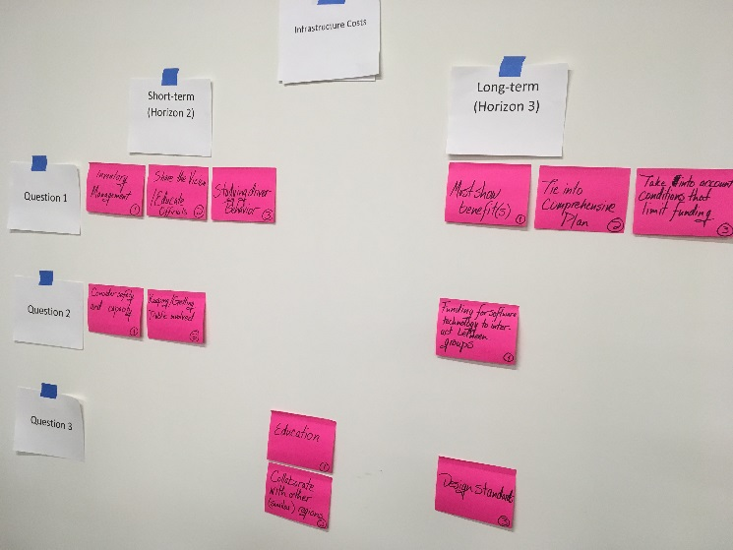
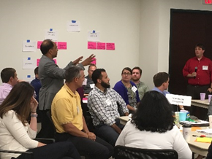
ACV Workshop 2
Workshop 2: Discussing the Impacts
  How will ACVs impact our work and how we reach our long-range goals and objectives?
  What gaps exist, what are our highest priority actions?
Notes:
Workshop 1: Clearing the Hype- August 23rd
An educational session on what we know today and what is coming in the next 5-10 years. Participants will leave with a raised awareness, education, and a clearer sense of the emerging and disruptive issue of Automated and Connected Vehicles or ACV and begin to grasp its growing near-term impact within transportation. Participants will learn about NCDOT’s early strategy and response to this impeding change and be exposed to both presentations and a panel discussion which summarize related research, legislation, and actions taken at the national and state levels, including other State DOTs and MPOs.
Workshop 2: Discussing the Impacts -September 20th
How will ACVs impact our work and how we reach our long-range goals and objectives in the areas of public transportation, transportation planning, land use, modeling and forecasting, fleet services, etc.
Workshop 3: Developing an Action Plan - October 25th
Determine key steps our region can take to prepare for and make the most of this game-changing technology by incorporating input from government, business, economic development and academia interests

Slide 21
Workshop 2 Results
Presentation Series:
Planning for Change – A Local Perspective
  Anna Gallup, CDOT, Bob Cook, CRPTO and Bjorn Hansen, Union County
Planning for Change – Regulatory and Practitioner Based Perspectives
  Paul Lewis of Eno Center for Transportation and Jitender Ramchandani of Virginia DRPT
NC Turnpike Authority – Triangle Expressway & Managed Mobility by Dennis Jernigan, NCTA
Planning for Change – The Next Frontier – Marty Milkovits, Cambridge Systematics
Breakout Session to Discuss Actions by time horizons
Notes:
Planning for Change - A Local Perspective - This panel discussion will explore how local planners/modelers are grappling with ACVs and what considerations their agencies are using to develop plans and forecasts influenced by this technology
Planning for Change – Regulatory and Practitioner based Perspectives –
ACV Policy Frameworks for the Federal, State, and Local Levels - presentation on the state of regulatory response (federal, state, local) across the country and the cascading impact in states (such as VA) Paul Lewis of Eno
Adapting to Transit/Rail ACV Change – Virginia’s Experience – practitioner based perspective on the resources, staff, and decisions (including Level 1 Transit automation) in VA.
Jitender Ramchandani of Virginia Department of Rail and Public Transportation
Planning for Change – The Next Frontier – Marty Milkovits
The next evolution in forecasting and scenario planning which builds upon shared local, national, regulatory, and practitioner perspectives.

Slide 22
Workshop 2: Breakout Session Results
Discussed Impacts
Identified Gaps in policy, planning, programming
Brainstormed and identified Priority Actions to address Gaps
Notes:
Note that W1 and W2 Summaries are available in the room.

Slide 23
Workshop 3: Breakout Session Results
Identify obstacles to
progress;
Developed solutions to
overcome barriers
Defined near term priority actions.
Notes:
Note that W1 and W2 Summaries are available in the room.

Slide 24
Roadmap Purpose
Automated and Connected Vehicle (ACV) Roadmap
Actions to Prepare the Greater Charlotte Region
The Roadmap Action Plan includes specific near term actions that partners in the region can take to enhance preparedness for ACV.
Given the fast pace of change with ACV technologies, this action plan is a living document.

Slide 25

Action Plan – Key themes
At a high level these actions include the following themes:
Continue to convene regional leadership/partners to discuss multimodal impacts issues and opportunities of new technologies, coordinate actions, and plans.
Consider ACV in planning studies and documents.
Take steps to update tools to be able to evaluate ACV impacts.
Before making significant major capital investments—such as new parking structures or road widenings— consider possible implications of ACV.
Continue to seek opportunities to educate and inform regional political leaders, agency leadership, and staff.
Be part of the state and national conversation on ACV, providing the voice of the regional perspective on ACV issues.
Identify opportunities to be partners in pilot tests for new technologies.
Notes:
Slide text to be tweaked yet…

Slide 26
Proposed Taskforce Mission
Identify, clarify, and affirm near term actions that can be influenced or controlled locally/regionally to prepare our communities, region and organizations for autonomous and connected vehicles.

Slide 27
Proposed Taskforce Mission
Identify, clarify, and affirm near term actions that can be influenced or controlled locally/regionally to prepare our communities, region and organizations for autonomous and connected vehicles.
On your own, take a few minutes to note:
What does success for this Taskforce look like?
What questions need to be answered by this Taskforce?
Turning to 3-4 neighbors… from the perspective that this statement must guide what the ACV Taskforce will do/seek to accomplish, share your responses to the above questions… then talk about:
What you like about this mission
What concerns you have with this mission
What elements are missing? Does this mission “overpromise?”

Slide 28
Proposed Taskforce Mission
Identify, clarify, and affirm near term actions that can be influenced or controlled locally/regionally to prepare our communities, region and organizations for autonomous and connected vehicles.
On your own, take a few minutes to note:
What does success for this Taskforce look like?
What questions need to be answered by this Taskforce?
Turning to 3-4 neighbors… from the perspective that this statement must guide what the ACV Taskforce will do/seek to accomplish, share your responses to the above questions… then talk about:
What you like about this mission
What concerns you have with this mission
What elements are missing? Does this mission “overpromise?”

Slide 29
Proposed Taskforce Mission
Identify, clarify, and affirm near term actions that can be influenced or controlled locally/regionally to prepare our communities, region and organizations for autonomous and connected vehicles.
On your own, take a few minutes to note:
What does success for this Taskforce look like?
What questions need to be answered by this Taskforce?
Turning to 3-4 neighbors… from the perspective that this statement must guide what the ACV Taskforce will do/seek to accomplish, share your responses to the above questions… then talk about:
What you like about this mission
What concerns you have with this mission
What elements are missing? Does this mission “overpromise?”

Slide 30
Proposed Taskforce Mission
Identify, clarify, and affirm near term actions that can be influenced or controlled locally/regionally to prepare our communities, region and organizations for autonomous and connected vehicles.
On your own, take a few minutes to note:
What does success for this Taskforce look like?
What questions need to be answered by this Taskforce?
Turning to 3-4 neighbors… from the perspective that this statement must guide what the ACV Taskforce will do/seek to accomplish, share your responses to the above questions… then talk about:
What you like about this mission
What concerns you have with this mission
What elements are missing? Does this mission “overpromise?”

Slide 31
Other Taskforce Considerations
Who else should be involved?
Concept for how we are organized:
“Advisors”
  3-4 members that serve to guide agendas, topics, and focus
Schedule

Slide 32
“Spring Break” Homework!
Read the Roadmap!
Come prepared at our next meeting to talk about 1-3 things that stood out to you.
Note and be ready to share what questions came up for you as you read through this document.
Finally, note and be ready with any ideas for how this Roadmap can best support the work of this Taskforce.

Slide 33
Thank You!

